Slide 1
LECTURE ON LIS VER 2 BOSY 2014 USING SCHOOL HEAD ACCOUNT
BY
ALFREDO C. MEDRANO
Planning Officer II
DIVISION OF ILOCOS NORTE

Slide 2
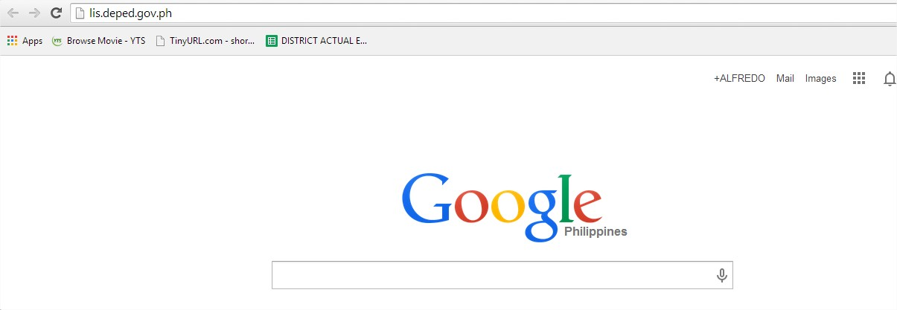
LOGIN TO LIS WEBSITE
LIS MANUAL MENU
LIS WEBSITE
LOGIN PAGE MENU
MANAGING OF SH ACCOUNT
CHANGE PASSWORD
CHANGE USERNAME
MANAGING PERSONNEL
ADD PERSONNEL ACCOUNT
REMOVE ACCOUNT
LOCK/DISABLE ACCOUNT
RESET PASSWORD
GUIDELINE FOR BOSY UPDATING
LEARNER INFORMATION SYSTEM
CREATE CLASSES
REMOVE CLASS
SET ADVISER/ADD PERSONNEL ACCOUNT
ENROLMENT OF LEARNER
ENROL LEARNER W/O LRN
BATCH ENROL OF LEARNER
ENROL TRANSFEREES (By LRN and By NAME)
PROFILE OF LEARNER
UPDATING OF PROFILE/UN-ENROL
SCHOOL FORMS
USING ANY BROWSER – IN THE ADDRESS BAR, TYPE LIS.DEPED.GOV.PH <enter>

Slide 3
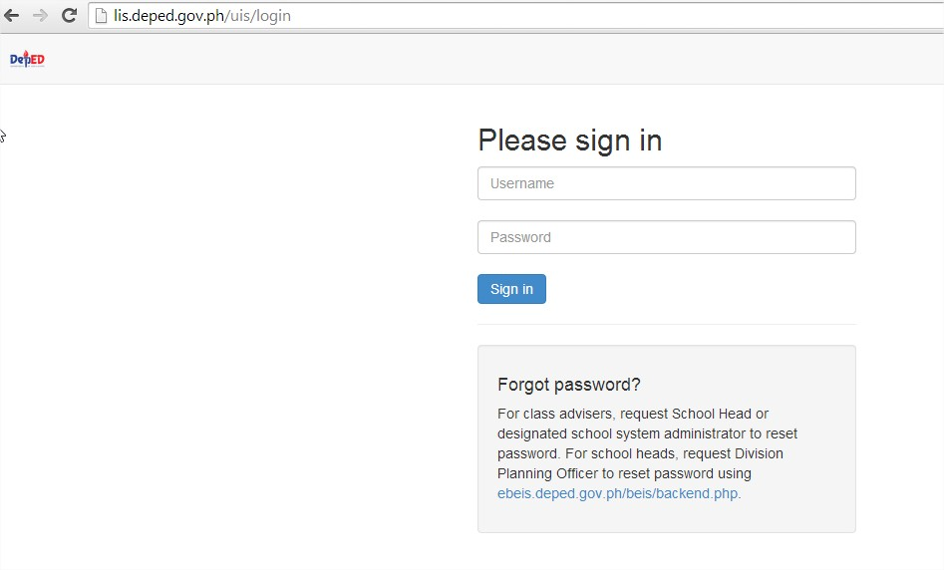
LOGIN PAGE
LIS MANUAL MENU
LIS WEBSITE
LOGIN PAGE MENU
MANAGING OF SH ACCOUNT
CHANGE PASSWORD
CHANGE USERNAME
MANAGING PERSONNEL
ADD PERSONNEL ACCOUNT
REMOVE ACCOUNT
LOCK/DISABLE ACCOUNT
RESET PASSWORD
GUIDELINE FOR BOSY UPDATING
LEARNER INFORMATION SYSTEM
CREATE CLASSES
REMOVE CLASS
SET ADVISER/ADD PERSONNEL ACCOUNT
ENROLMENT OF LEARNER
ENROL LEARNER W/O LRN
BATCH ENROL OF LEARNER
ENROL TRANSFEREES (By LRN and By NAME)
PROFILE OF LEARNER
UPDATING OF PROFILE/UN-ENROL
SCHOOL FORMS
Type username and password of school account (if you forgot your username and password, request reset to your planning officer)

Slide 4
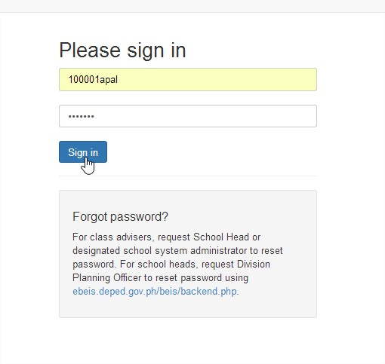
LIS MANUAL MENU
LIS WEBSITE
LOGIN PAGE MENU
MANAGING OF SH ACCOUNT
CHANGE PASSWORD
CHANGE USERNAME
MANAGING PERSONNEL
ADD PERSONNEL ACCOUNT
REMOVE ACCOUNT
LOCK/DISABLE ACCOUNT
RESET PASSWORD
GUIDELINE FOR BOSY UPDATING
LEARNER INFORMATION SYSTEM
CREATE CLASSES
REMOVE CLASS
SET ADVISER/ADD PERSONNEL ACCOUNT
ENROLMENT OF LEARNER
ENROL LEARNER W/O LRN
BATCH ENROL OF LEARNER
ENROL TRANSFEREES (By LRN and By NAME)
PROFILE OF LEARNER
UPDATING OF PROFILE/UN-ENROL
SCHOOL FORMS
AFTER TYPING THE USERNAME AND PASSWORD, CLICK SIGN IN

Slide 5
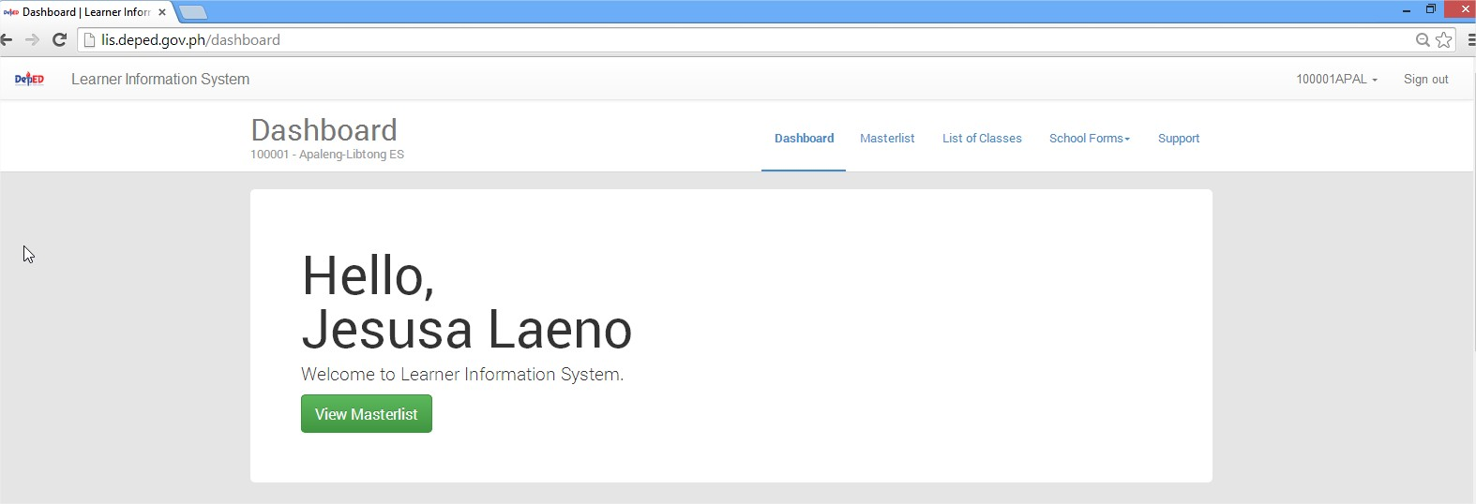
LIS MANUAL MENU
LIS WEBSITE
LOGIN PAGE MENU
MANAGING OF SH ACCOUNT
CHANGE PASSWORD
CHANGE USERNAME
MANAGING PERSONNEL
ADD PERSONNEL ACCOUNT
REMOVE ACCOUNT
LOCK/DISABLE ACCOUNT
RESET PASSWORD
GUIDELINE FOR BOSY UPDATING
LEARNER INFORMATION SYSTEM
CREATE CLASSES
REMOVE CLASS
SET ADVISER/ADD PERSONNEL ACCOUNT
ENROLMENT OF LEARNER
ENROL LEARNER W/O LRN
BATCH ENROL OF LEARNER
ENROL TRANSFEREES (By LRN and By NAME)
PROFILE OF LEARNER
UPDATING OF PROFILE/UN-ENROL
SCHOOL FORMS

Slide 6
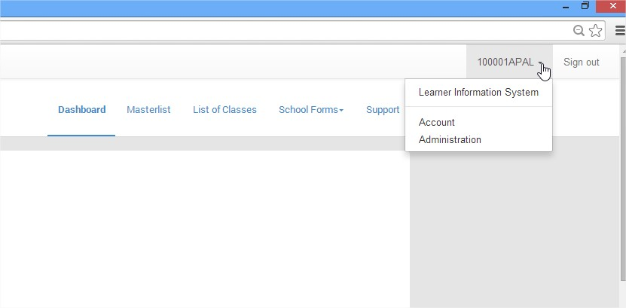
LIS MANUAL MENU
LIS WEBSITE
LOGIN PAGE MENU
MANAGING OF SH ACCOUNT
CHANGE PASSWORD
CHANGE USERNAME
MANAGING PERSONNEL
ADD PERSONNEL ACCOUNT
REMOVE ACCOUNT
LOCK/DISABLE ACCOUNT
RESET PASSWORD
GUIDELINE FOR BOSY UPDATING
LEARNER INFORMATION SYSTEM
CREATE CLASSES
REMOVE CLASS
SET ADVISER/ADD PERSONNEL ACCOUNT
ENROLMENT OF LEARNER
ENROL LEARNER W/O LRN
BATCH ENROL OF LEARNER
ENROL TRANSFEREES (By LRN and By NAME)
PROFILE OF LEARNER
UPDATING OF PROFILE/UN-ENROL
SCHOOL FORMS
MANAGING OF ACCOUNT OF SCHOOL HEAD
Click Here then click Account

Slide 7
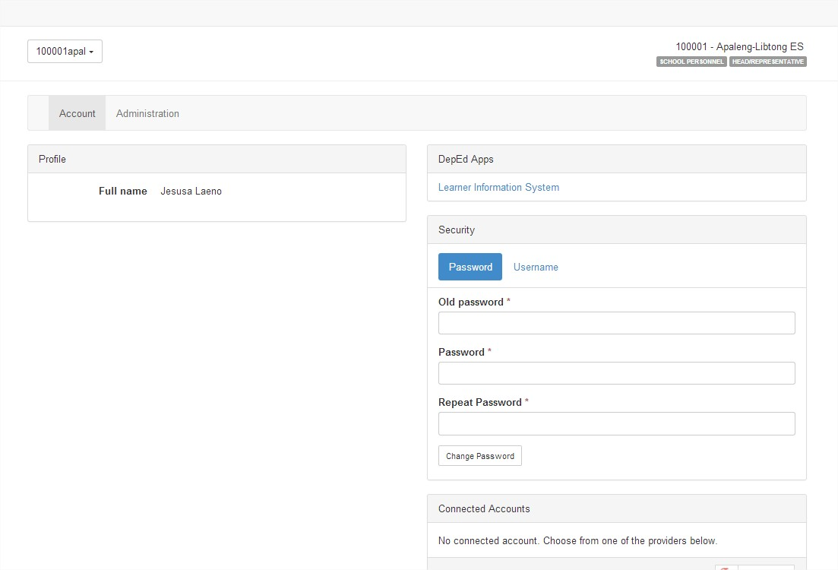
LIS MANUAL MENU
LIS WEBSITE
LOGIN PAGE MENU
MANAGING OF SH ACCOUNT
CHANGE PASSWORD
CHANGE USERNAME
MANAGING PERSONNEL
ADD PERSONNEL ACCOUNT
REMOVE ACCOUNT
LOCK/DISABLE ACCOUNT
RESET PASSWORD
GUIDELINE FOR BOSY UPDATING
LEARNER INFORMATION SYSTEM
CREATE CLASSES
REMOVE CLASS
SET ADVISER/ADD PERSONNEL ACCOUNT
ENROLMENT OF LEARNER
ENROL LEARNER W/O LRN
BATCH ENROL OF LEARNER
ENROL TRANSFEREES (By LRN and By NAME)
PROFILE OF LEARNER
UPDATING OF PROFILE/UN-ENROL
SCHOOL FORMS
To change Password, just type the old password, then type the new password and repeat password, then Click Change Password

Slide 8
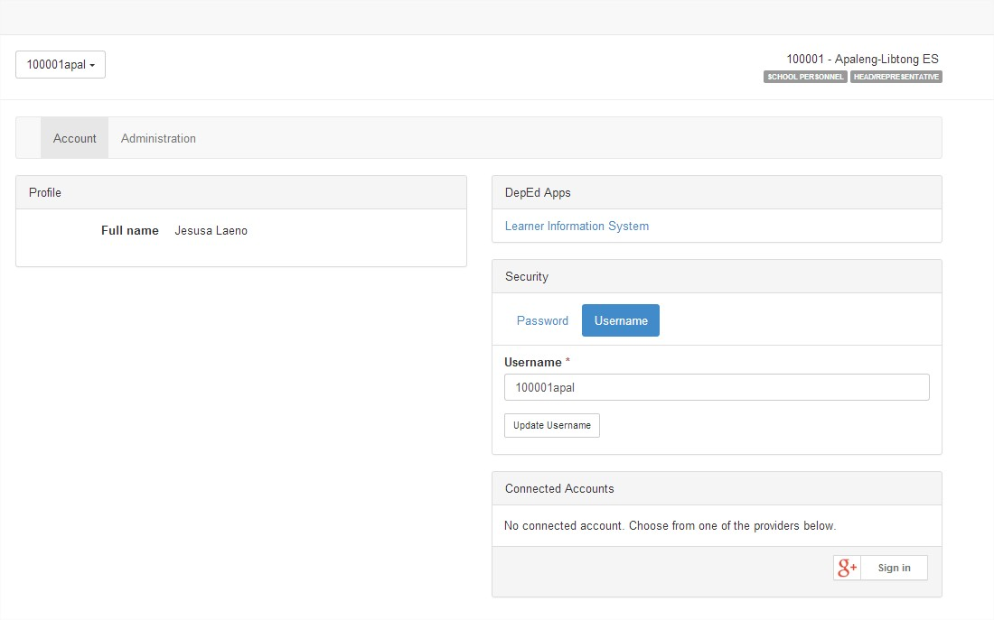
LIS MANUAL MENU
LIS WEBSITE
LOGIN PAGE MENU
MANAGING OF SH ACCOUNT
CHANGE PASSWORD
CHANGE USERNAME
MANAGING PERSONNEL
ADD PERSONNEL ACCOUNT
REMOVE ACCOUNT
LOCK/DISABLE ACCOUNT
RESET PASSWORD
GUIDELINE FOR BOSY UPDATING
LEARNER INFORMATION SYSTEM
CREATE CLASSES
REMOVE CLASS
SET ADVISER/ADD PERSONNEL ACCOUNT
ENROLMENT OF LEARNER
ENROL LEARNER W/O LRN
BATCH ENROL OF LEARNER
ENROL TRANSFEREES (By LRN and By NAME)
PROFILE OF LEARNER
UPDATING OF PROFILE/UN-ENROL
SCHOOL FORMS
Click Here
To change the Username of the School Account, Click Username, you can use your deped email, then Click Update Username
To get your DepED Email, login to depedverify.appspot.com

Slide 9
LIS MANUAL MENU
LIS WEBSITE
LOGIN PAGE MENU
MANAGING OF SH ACCOUNT
CHANGE PASSWORD
CHANGE USERNAME
MANAGING PERSONNEL
ADD PERSONNEL ACCOUNT
REMOVE ACCOUNT
LOCK/DISABLE ACCOUNT
RESET PASSWORD
GUIDELINE FOR BOSY UPDATING
LEARNER INFORMATION SYSTEM
CREATE CLASSES
REMOVE CLASS
SET ADVISER/ADD PERSONNEL ACCOUNT
ENROLMENT OF LEARNER
ENROL LEARNER W/O LRN
BATCH ENROL OF LEARNER
ENROL TRANSFEREES (By LRN and By NAME)
PROFILE OF LEARNER
UPDATING OF PROFILE/UN-ENROL
SCHOOL FORMS
MANAGING PERSONNEL
Click Here then click Administration

Slide 10
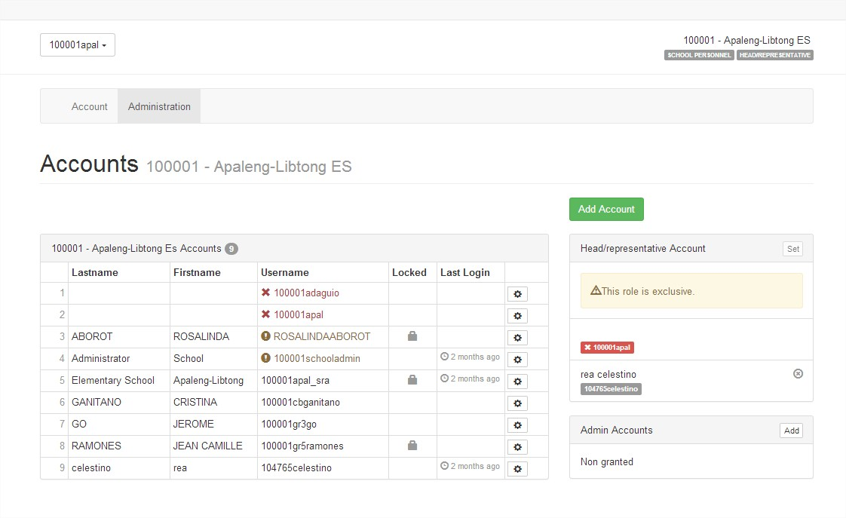
LIS MANUAL MENU
LIS WEBSITE
LOGIN PAGE MENU
MANAGING OF SH ACCOUNT
CHANGE PASSWORD
CHANGE USERNAME
MANAGING PERSONNEL
ADD PERSONNEL ACCOUNT
REMOVE ACCOUNT
LOCK/DISABLE ACCOUNT
RESET PASSWORD
GUIDELINE FOR BOSY UPDATING
LEARNER INFORMATION SYSTEM
CREATE CLASSES
REMOVE CLASS
SET ADVISER/ADD PERSONNEL ACCOUNT
ENROLMENT OF LEARNER
ENROL LEARNER W/O LRN
BATCH ENROL OF LEARNER
ENROL TRANSFEREES (By LRN and By NAME)
PROFILE OF LEARNER
UPDATING OF PROFILE/UN-ENROL
SCHOOL FORMS
ADD PERSONNEL ACCOUNT without B-day, TIN Number
Click Add Account

Slide 11
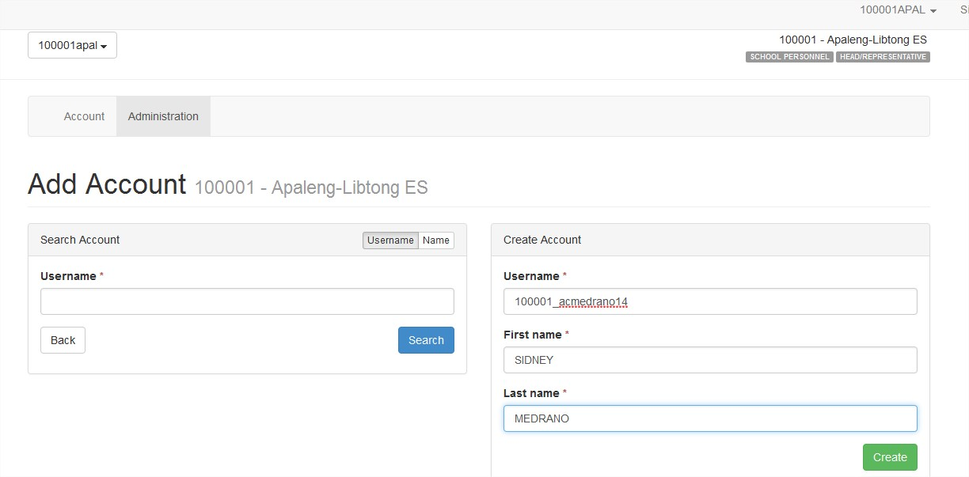
LIS MANUAL MENU
LIS WEBSITE
LOGIN PAGE MENU
MANAGING OF SH ACCOUNT
CHANGE PASSWORD
CHANGE USERNAME
MANAGING PERSONNEL
ADD PERSONNEL ACCOUNT
REMOVE ACCOUNT
LOCK/DISABLE ACCOUNT
RESET PASSWORD
GUIDELINE FOR BOSY UPDATING
LEARNER INFORMATION SYSTEM
CREATE CLASSES
REMOVE CLASS
SET ADVISER/ADD PERSONNEL ACCOUNT
ENROLMENT OF LEARNER
ENROL LEARNER W/O LRN
BATCH ENROL OF LEARNER
ENROL TRANSFEREES (By LRN and By NAME)
PROFILE OF LEARNER
UPDATING OF PROFILE/UN-ENROL
SCHOOL FORMS
Type the Username (ex. Schoolid_InitialFirstMiddleLastname2lastdigitcurrentyearb (100001_somedrano14), type First Name, and Last Name, then Click Create

Slide 12
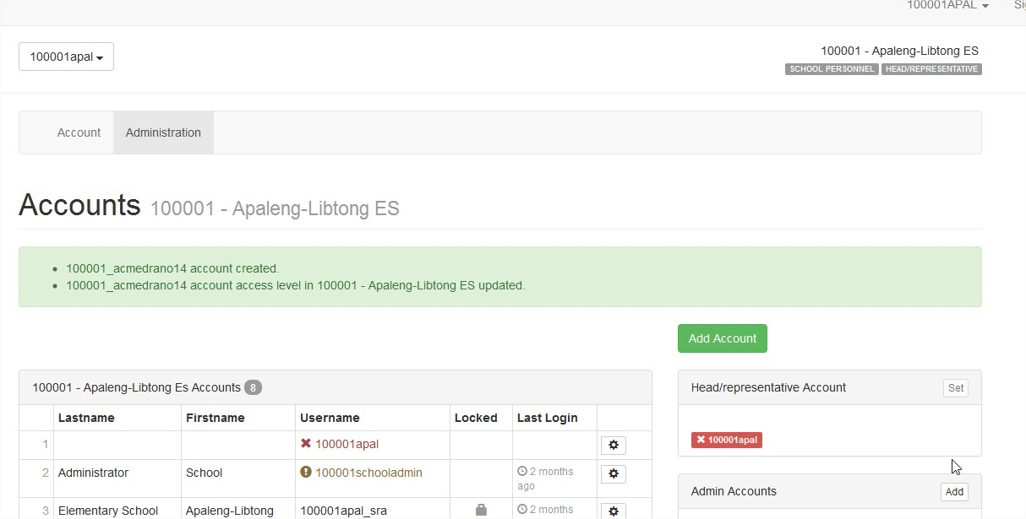
LIS MANUAL MENU
LIS WEBSITE
LOGIN PAGE MENU
MANAGING OF SH ACCOUNT
CHANGE PASSWORD
CHANGE USERNAME
MANAGING PERSONNEL
ADD PERSONNEL ACCOUNT
REMOVE ACCOUNT
LOCK/DISABLE ACCOUNT
RESET PASSWORD
GUIDELINE FOR BOSY UPDATING
LEARNER INFORMATION SYSTEM
CREATE CLASSES
REMOVE CLASS
SET ADVISER/ADD PERSONNEL ACCOUNT
ENROLMENT OF LEARNER
ENROL LEARNER W/O LRN
BATCH ENROL OF LEARNER
ENROL TRANSFEREES (By LRN and By NAME)
PROFILE OF LEARNER
UPDATING OF PROFILE/UN-ENROL
SCHOOL FORMS
PLEASE READ

Slide 13
LIS MANUAL MENU
LIS WEBSITE
LOGIN PAGE MENU
MANAGING OF SH ACCOUNT
CHANGE PASSWORD
CHANGE USERNAME
MANAGING PERSONNEL
ADD PERSONNEL ACCOUNT
REMOVE ACCOUNT
LOCK/DISABLE ACCOUNT
RESET PASSWORD
GUIDELINE FOR BOSY UPDATING
LEARNER INFORMATION SYSTEM
CREATE CLASSES
REMOVE CLASS
SET ADVISER/ADD PERSONNEL ACCOUNT
ENROLMENT OF LEARNER
ENROL LEARNER W/O LRN
BATCH ENROL OF LEARNER
ENROL TRANSFEREES (By LRN and By NAME)
PROFILE OF LEARNER
UPDATING OF PROFILE/UN-ENROL
SCHOOL FORMS
HOW TO REMOVE ACCOUNT OF PERSONNEL
Click Here then click Administration

Slide 14
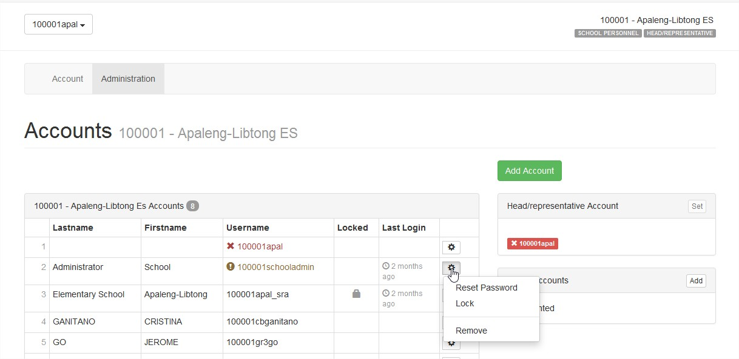
LIS MANUAL MENU
LIS WEBSITE
LOGIN PAGE MENU
MANAGING OF SH ACCOUNT
CHANGE PASSWORD
CHANGE USERNAME
MANAGING PERSONNEL
ADD PERSONNEL ACCOUNT
REMOVE ACCOUNT
LOCK/DISABLE ACCOUNT
RESET PASSWORD
GUIDELINE FOR BOSY UPDATING
LEARNER INFORMATION SYSTEM
CREATE CLASSES
REMOVE CLASS
SET ADVISER/ADD PERSONNEL ACCOUNT
ENROLMENT OF LEARNER
ENROL LEARNER W/O LRN
BATCH ENROL OF LEARNER
ENROL TRANSFEREES (By LRN and By NAME)
PROFILE OF LEARNER
UPDATING OF PROFILE/UN-ENROL
SCHOOL FORMS
REMOVING ACCOUNT
Click Here
Click then click remove

Slide 15
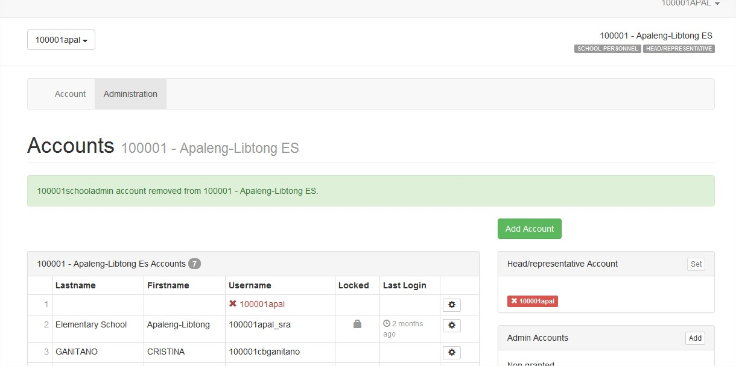
LIS MANUAL MENU
LIS WEBSITE
LOGIN PAGE MENU
MANAGING OF SH ACCOUNT
CHANGE PASSWORD
CHANGE USERNAME
MANAGING PERSONNEL
ADD PERSONNEL ACCOUNT
REMOVE ACCOUNT
LOCK/DISABLE ACCOUNT
RESET PASSWORD
GUIDELINE FOR BOSY UPDATING
LEARNER INFORMATION SYSTEM
CREATE CLASSES
REMOVE CLASS
SET ADVISER/ADD PERSONNEL ACCOUNT
ENROLMENT OF LEARNER
ENROL LEARNER W/O LRN
BATCH ENROL OF LEARNER
ENROL TRANSFEREES (By LRN and By NAME)
PROFILE OF LEARNER
UPDATING OF PROFILE/UN-ENROL
SCHOOL FORMS
Please take note that you cannot re-use the username that you have removed

Slide 16
LIS MANUAL MENU
LIS WEBSITE
LOGIN PAGE MENU
MANAGING OF SH ACCOUNT
CHANGE PASSWORD
CHANGE USERNAME
MANAGING PERSONNEL
ADD PERSONNEL ACCOUNT
REMOVE ACCOUNT
LOCK/DISABLE ACCOUNT
RESET PASSWORD
GUIDELINE FOR BOSY UPDATING
LEARNER INFORMATION SYSTEM
CREATE CLASSES
REMOVE CLASS
SET ADVISER/ADD PERSONNEL ACCOUNT
ENROLMENT OF LEARNER
ENROL LEARNER W/O LRN
BATCH ENROL OF LEARNER
ENROL TRANSFEREES (By LRN and By NAME)
PROFILE OF LEARNER
UPDATING OF PROFILE/UN-ENROL
SCHOOL FORMS
DISABLE/LOCK PERSONNEL ACCOUNT
Click Here then click Administration

Slide 17
LIS MANUAL MENU
LIS WEBSITE
LOGIN PAGE MENU
MANAGING OF SH ACCOUNT
CHANGE PASSWORD
CHANGE USERNAME
MANAGING PERSONNEL
ADD PERSONNEL ACCOUNT
REMOVE ACCOUNT
LOCK/DISABLE ACCOUNT
RESET PASSWORD
GUIDELINE FOR BOSY UPDATING
LEARNER INFORMATION SYSTEM
CREATE CLASSES
REMOVE CLASS
SET ADVISER/ADD PERSONNEL ACCOUNT
ENROLMENT OF LEARNER
ENROL LEARNER W/O LRN
BATCH ENROL OF LEARNER
ENROL TRANSFEREES (By LRN and By NAME)
PROFILE OF LEARNER
UPDATING OF PROFILE/UN-ENROL
SCHOOL FORMS
Click Here
Click then click Lock

Slide 18
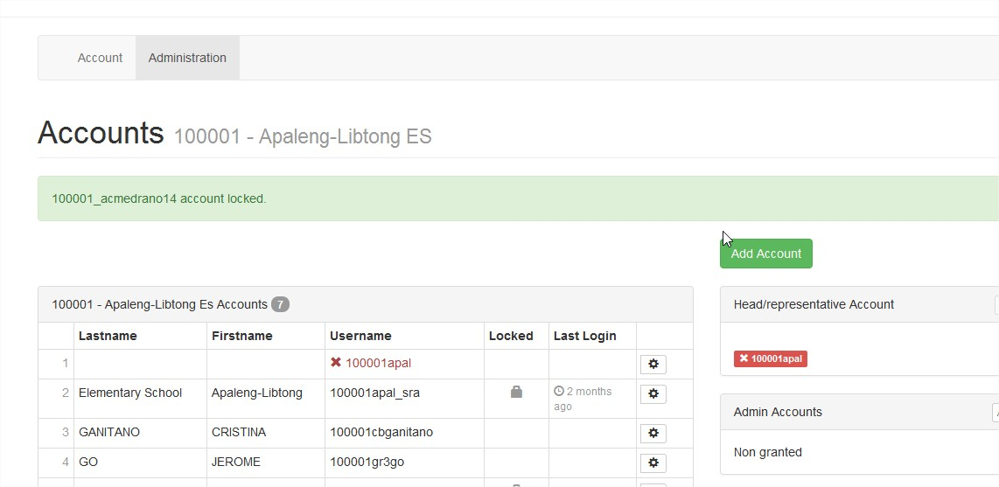
LIS MANUAL MENU
LIS WEBSITE
LOGIN PAGE MENU
MANAGING OF SH ACCOUNT
CHANGE PASSWORD
CHANGE USERNAME
MANAGING PERSONNEL
ADD PERSONNEL ACCOUNT
REMOVE ACCOUNT
LOCK/DISABLE ACCOUNT
RESET PASSWORD
GUIDELINE FOR BOSY UPDATING
LEARNER INFORMATION SYSTEM
CREATE CLASSES
REMOVE CLASS
SET ADVISER/ADD PERSONNEL ACCOUNT
ENROLMENT OF LEARNER
ENROL LEARNER W/O LRN
BATCH ENROL OF LEARNER
ENROL TRANSFEREES (By LRN and By NAME)
PROFILE OF LEARNER
UPDATING OF PROFILE/UN-ENROL
SCHOOL FORMS
To unlock, you can repeat the procedure

Slide 19
LIS MANUAL MENU
LIS WEBSITE
LOGIN PAGE MENU
MANAGING OF SH ACCOUNT
CHANGE PASSWORD
CHANGE USERNAME
MANAGING PERSONNEL
ADD PERSONNEL ACCOUNT
REMOVE ACCOUNT
LOCK/DISABLE ACCOUNT
RESET PASSWORD
GUIDELINE FOR BOSY UPDATING
LEARNER INFORMATION SYSTEM
CREATE CLASSES
REMOVE CLASS
SET ADVISER/ADD PERSONNEL ACCOUNT
ENROLMENT OF LEARNER
ENROL LEARNER W/O LRN
BATCH ENROL OF LEARNER
ENROL TRANSFEREES (By LRN and By NAME)
PROFILE OF LEARNER
UPDATING OF PROFILE/UN-ENROL
SCHOOL FORMS
RESET PASSWORD OF CLASS ADVISER
Click Here then click Administration

Slide 20
LIS MANUAL MENU
LIS WEBSITE
LOGIN PAGE MENU
MANAGING OF SH ACCOUNT
CHANGE PASSWORD
CHANGE USERNAME
MANAGING PERSONNEL
ADD PERSONNEL ACCOUNT
REMOVE ACCOUNT
LOCK/DISABLE ACCOUNT
RESET PASSWORD
GUIDELINE FOR BOSY UPDATING
LEARNER INFORMATION SYSTEM
CREATE CLASSES
REMOVE CLASS
SET ADVISER/ADD PERSONNEL ACCOUNT
ENROLMENT OF LEARNER
ENROL LEARNER W/O LRN
BATCH ENROL OF LEARNER
ENROL TRANSFEREES (By LRN and By NAME)
PROFILE OF LEARNER
UPDATING OF PROFILE/UN-ENROL
SCHOOL FORMS
Click Here
Click then click Reset Password

Slide 21
LIS MANUAL MENU
LIS WEBSITE
LOGIN PAGE MENU
MANAGING OF SH ACCOUNT
CHANGE PASSWORD
CHANGE USERNAME
MANAGING PERSONNEL
ADD PERSONNEL ACCOUNT
REMOVE ACCOUNT
LOCK/DISABLE ACCOUNT
RESET PASSWORD
GUIDELINE FOR BOSY UPDATING
LEARNER INFORMATION SYSTEM
CREATE CLASSES
REMOVE CLASS
SET ADVISER/ADD PERSONNEL ACCOUNT
ENROLMENT OF LEARNER
ENROL LEARNER W/O LRN
BATCH ENROL OF LEARNER
ENROL TRANSFEREES (By LRN and By NAME)
PROFILE OF LEARNER
UPDATING OF PROFILE/UN-ENROL
SCHOOL FORMS
password reset

Slide 22
LIS MANUAL MENU
LIS WEBSITE
LOGIN PAGE MENU
MANAGING OF SH ACCOUNT
CHANGE PASSWORD
CHANGE USERNAME
MANAGING PERSONNEL
ADD PERSONNEL ACCOUNT
REMOVE ACCOUNT
LOCK/DISABLE ACCOUNT
RESET PASSWORD
GUIDELINE FOR BOSY UPDATING
LEARNER INFORMATION SYSTEM
CREATE CLASSES
REMOVE CLASS
SET ADVISER/ADD PERSONNEL ACCOUNT
ENROLMENT OF LEARNER
ENROL LEARNER W/O LRN
BATCH ENROL OF LEARNER
ENROL TRANSFEREES (By LRN and By NAME)
PROFILE OF LEARNER
UPDATING OF PROFILE/UN-ENROL
SCHOOL FORMS
Preliminary Tasks Prior to BOSY Updating of Enrollment & Learner Profile

Slide 23
HOW TO CHANGE THE NAME OF SCHOOL REPRESENTATIVE
Division Planning Unit
The Division Planning Unit in collaboration with the ICT Coordinator shall review the list of school users to ensure that all school heads including the newly appointed ones and those who have been transferred to another school are properly set up and provided with appropriate access rights in the system. Likewise access of outgoing school heads must be disabled in the system.
School head accounts are identified with a “School Representative” user type in the EBEIS backend facility. Hence, to view all school head accounts for a specific division, select “School Representative” from the drop-down list of User Type, then click on “View” to update the user profile of a specific school head.
For school heads who have been transferred to another school, the following procedures shall be followed:
At the backend facility, retrieve the school head’s existing user account which would be the username from his/her previous school assignment.
View account profile in the Account Detail page, then change the School/Office Information data to his/her new school assignment.
Advise the school head to log into the LIS using his/her existing username and password which would likely be a username bearing his/her former school id. After successfully logging into the LIS, he/she must change his/her username to his/her email account (preferably deped.gov.ph, if they have already registered in the DepEd email system) that uniquely identifies him/her. This automatically updates the school head’s username in the EBEIS.
For school heads with multiple school assignments, a request shall be made through the listrackermain@gmail.com to set up the school head’s account to access his/her schools using only one account. The LIS Administration Group at the central office shall be responsible for setting up this account upon request.

Slide 24
School Level Review of Users and List of Classes
At the school level, the School Head and/or the designated School ICT Coordinator/LIS-EBEIS Coordinator shall review and update the list of class advisers for SY 2014.
For the new Class Adviser personnel, a personnel record shall be created including a default user account. In the interim, new class advisers shall be created through the List of Classes-Set Adviser facility. After the personnel record is created, the personnel is assigned to the class and a default username in the format of school_id + “_” + initial letters of first name and middle name + last name + last 2 digits of current SY (e.g. Personnel Name is Maria Antonio Flores for school id 301265, the default username is 301265_maflores14). A default password that is the same as the username is also created. The individual personnel may change his/her username and password. It is advised to use the individual’s email account (preferably the deped.gov.ph, if he/she had been registered to the DepEd email system).
User accounts of outgoing (separated or retired) Class Advisers and volunteer teachers shall be disabled.
As a system policy, volunteer teachers who were assigned as Class Advisers shall not be registered in the LIS. Classes that are being handled by a volunteer teacher must be registered under the name and account of the nationally funded school head/teacher-in-charge.
The School Heads in collaboration with their School ICT Coordinators shall review the list of classes and class advisers for the SY 2014-2015. Classes from the previous school year (i.e. SY 2013) have been imported to the new school year, SY 2014.
Review the List of Classes with the section names, grade/s offering and assign the Class Adviser. Change class definition, remove class or add additional class to a grade level as necessary.
In addition, if the class is part of a shifting schedule that is being implemented by the school, the appropriate data on shift (i.e. 1st Shift, 2nd Shift, 3rd Shift, 4th Shift) must be defined as an attribute of the Class.

Slide 25
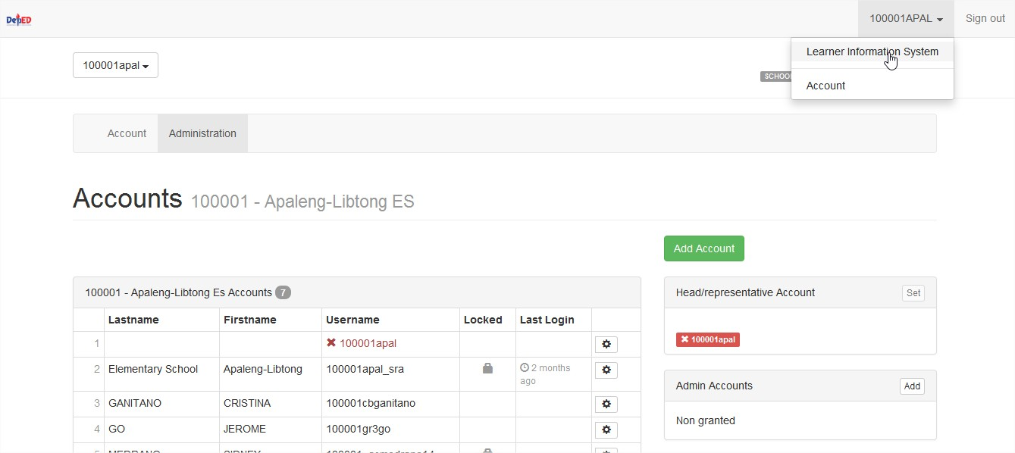
LIS MANUAL MENU
LIS WEBSITE
LOGIN PAGE MENU
MANAGING OF SH ACCOUNT
CHANGE PASSWORD
CHANGE USERNAME
MANAGING PERSONNEL
ADD PERSONNEL ACCOUNT
REMOVE ACCOUNT
LOCK/DISABLE ACCOUNT
RESET PASSWORD
GUIDELINE FOR BOSY UPDATING
LEARNER INFORMATION SYSTEM
CREATE CLASSES
REMOVE CLASS
SET ADVISER/ADD PERSONNEL ACCOUNT
ENROLMENT OF LEARNER
ENROL LEARNER W/O LRN
BATCH ENROL OF LEARNER
ENROL TRANSFEREES (By LRN and By NAME)
PROFILE OF LEARNER
UPDATING OF PROFILE/UN-ENROL
SCHOOL FORMS
Click here
After Managing or Updating the Personnel Account, go to Learner Information System Dashboard follow the big Arrow

Slide 26
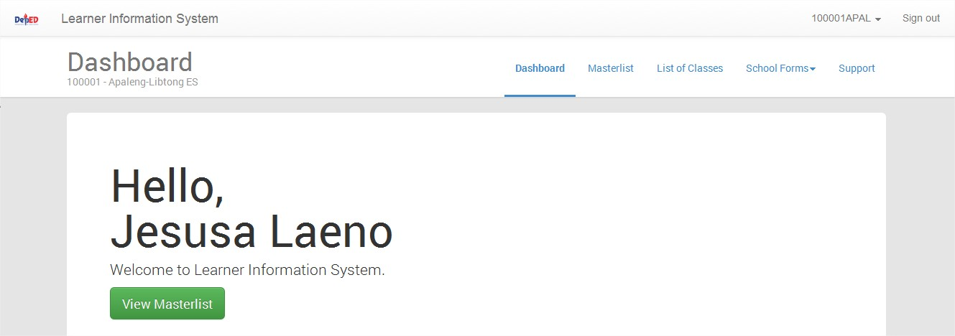
LIS MANUAL MENU
LIS WEBSITE
LOGIN PAGE MENU
MANAGING OF SH ACCOUNT
CHANGE PASSWORD
CHANGE USERNAME
MANAGING PERSONNEL
ADD PERSONNEL ACCOUNT
REMOVE ACCOUNT
LOCK/DISABLE ACCOUNT
RESET PASSWORD
GUIDELINE FOR BOSY UPDATING
LEARNER INFORMATION SYSTEM
CREATE CLASSES
REMOVE CLASS
SET ADVISER/ADD PERSONNEL ACCOUNT
ENROLMENT OF LEARNER
ENROL LEARNER W/O LRN
BATCH ENROL OF LEARNER
ENROL TRANSFEREES (By LRN and By NAME)
PROFILE OF LEARNER
UPDATING OF PROFILE/UN-ENROL
SCHOOL FORMS

Slide 27
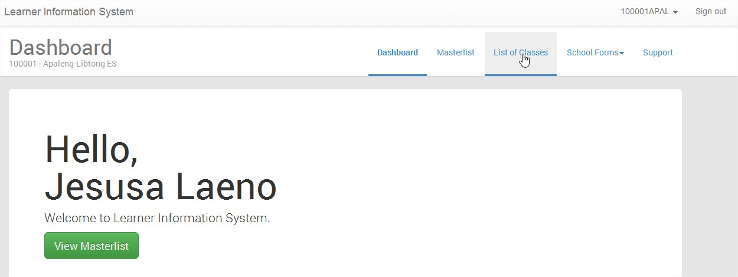
LIS MANUAL MENU
LIS WEBSITE
LOGIN PAGE MENU
MANAGING OF SH ACCOUNT
CHANGE PASSWORD
CHANGE USERNAME
MANAGING PERSONNEL
ADD PERSONNEL ACCOUNT
REMOVE ACCOUNT
LOCK/DISABLE ACCOUNT
RESET PASSWORD
GUIDELINE FOR BOSY UPDATING
LEARNER INFORMATION SYSTEM
CREATE CLASSES
REMOVE CLASS
SET ADVISER/ADD PERSONNEL ACCOUNT
ENROLMENT OF LEARNER
ENROL LEARNER W/O LRN
BATCH ENROL OF LEARNER
ENROL TRANSFEREES (By LRN and By NAME)
PROFILE OF LEARNER
UPDATING OF PROFILE/UN-ENROL
SCHOOL FORMS
CLICK LIST OF CLASSES TO DISPLAY THE LIST OF CLASSES FOR SY 2014-2015, AUTOMATICALLY IMPORTED THE CLASSES LAST SY 2013-2014

Slide 28
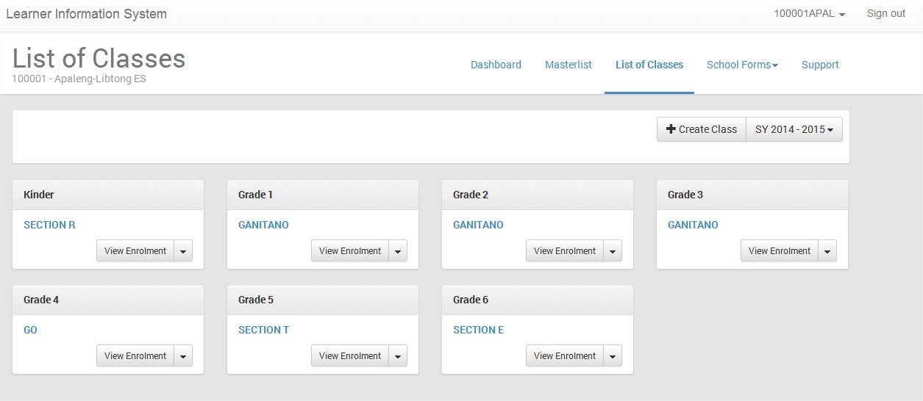
LIS MANUAL MENU
LIS WEBSITE
LOGIN PAGE MENU
MANAGING OF SH ACCOUNT
CHANGE PASSWORD
CHANGE USERNAME
MANAGING PERSONNEL
ADD PERSONNEL ACCOUNT
REMOVE ACCOUNT
LOCK/DISABLE ACCOUNT
RESET PASSWORD
GUIDELINE FOR BOSY UPDATING
LEARNER INFORMATION SYSTEM
CREATE CLASSES
REMOVE CLASS
SET ADVISER/ADD PERSONNEL ACCOUNT
ENROLMENT OF LEARNER
ENROL LEARNER W/O LRN
BATCH ENROL OF LEARNER
ENROL TRANSFEREES (By LRN and By NAME)
PROFILE OF LEARNER
UPDATING OF PROFILE/UN-ENROL
SCHOOL FORMS
LIST OF CLASSES PAGE

Slide 29
LIS MANUAL MENU
LIS WEBSITE
LOGIN PAGE MENU
MANAGING OF SH ACCOUNT
CHANGE PASSWORD
CHANGE USERNAME
MANAGING PERSONNEL
ADD PERSONNEL ACCOUNT
REMOVE ACCOUNT
LOCK/DISABLE ACCOUNT
RESET PASSWORD
GUIDELINE FOR BOSY UPDATING
LEARNER INFORMATION SYSTEM
CREATE CLASSES
REMOVE CLASS
SET ADVISER/ADD PERSONNEL ACCOUNT
ENROLMENT OF LEARNER
ENROL LEARNER W/O LRN
BATCH ENROL OF LEARNER
ENROL TRANSFEREES (By LRN and By NAME)
PROFILE OF LEARNER
UPDATING OF PROFILE/UN-ENROL
SCHOOL FORMS
CREATING A CLASS OR SECTION
CLICK CREATE A CLASS

Slide 30
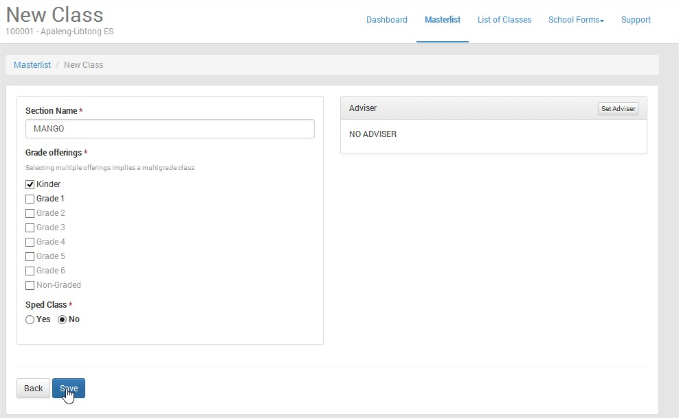
LIS MANUAL MENU
LIS WEBSITE
LOGIN PAGE MENU
MANAGING OF SH ACCOUNT
CHANGE PASSWORD
CHANGE USERNAME
MANAGING PERSONNEL
ADD PERSONNEL ACCOUNT
REMOVE ACCOUNT
LOCK/DISABLE ACCOUNT
RESET PASSWORD
GUIDELINE FOR BOSY UPDATING
LEARNER INFORMATION SYSTEM
CREATE CLASSES
REMOVE CLASS
SET ADVISER/ADD PERSONNEL ACCOUNT
ENROLMENT OF LEARNER
ENROL LEARNER W/O LRN
BATCH ENROL OF LEARNER
ENROL TRANSFEREES (By LRN and By NAME)
PROFILE OF LEARNER
UPDATING OF PROFILE/UN-ENROL
SCHOOL FORMS
TYPE THE NAME OF SECTION AND CLICK THE GRADE LEVEL, DO NOT CLICK 2 OR MORE GRADE LEVEL THEN CLICK SAVE TO CREATE CLASS/SECTION MANGO IN KINDER

Slide 31
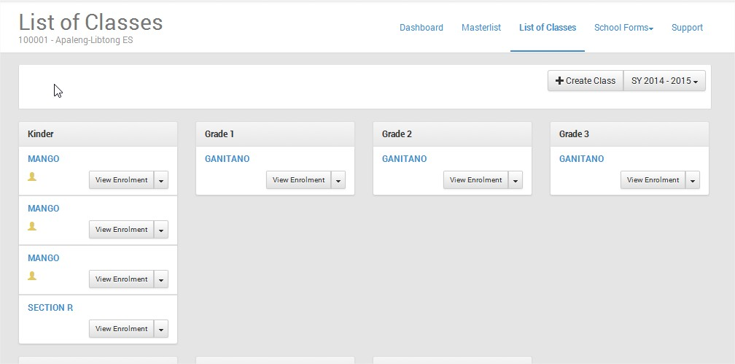
LIS MANUAL MENU
LIS WEBSITE
LOGIN PAGE MENU
MANAGING OF SH ACCOUNT
CHANGE PASSWORD
CHANGE USERNAME
MANAGING PERSONNEL
ADD PERSONNEL ACCOUNT
REMOVE ACCOUNT
LOCK/DISABLE ACCOUNT
RESET PASSWORD
GUIDELINE FOR BOSY UPDATING
LEARNER INFORMATION SYSTEM
CREATE CLASSES
REMOVE CLASS
SET ADVISER/ADD PERSONNEL ACCOUNT
ENROLMENT OF LEARNER
ENROL LEARNER W/O LRN
BATCH ENROL OF LEARNER
ENROL TRANSFEREES (By LRN and By NAME)
PROFILE OF LEARNER
UPDATING OF PROFILE/UN-ENROL
SCHOOL FORMS
Section Mango is created
IF YOU NOTICE THAT YOU HAVE CREATED 2 MORE MORE CLASSES, THIS IS BECAUSE OF BAD GATEWAY, YOU MUST REMOVE IT

Slide 32
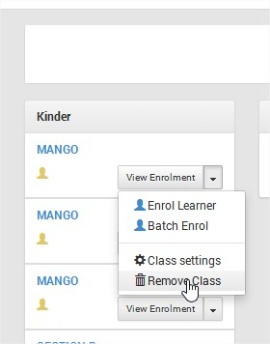
LIS MANUAL MENU
LIS WEBSITE
LOGIN PAGE MENU
MANAGING OF SH ACCOUNT
CHANGE PASSWORD
CHANGE USERNAME
MANAGING PERSONNEL
ADD PERSONNEL ACCOUNT
REMOVE ACCOUNT
LOCK/DISABLE ACCOUNT
RESET PASSWORD
GUIDELINE FOR BOSY UPDATING
LEARNER INFORMATION SYSTEM
CREATE CLASSES
REMOVE CLASS
SET ADVISER/ADD PERSONNEL ACCOUNT
ENROLMENT OF LEARNER
ENROL LEARNER W/O LRN
BATCH ENROL OF LEARNER
ENROL TRANSFEREES (By LRN and By NAME)
PROFILE OF LEARNER
UPDATING OF PROFILE/UN-ENROL
SCHOOL FORMS
REMOVING A CLASS OR SECTION
Click Here
IN THE LIST OF CLASSES, CLICK THE INVERTED TRIANGLE OR THE LISTDOWN MENU, SELECT REMOVE CLASS

Slide 33
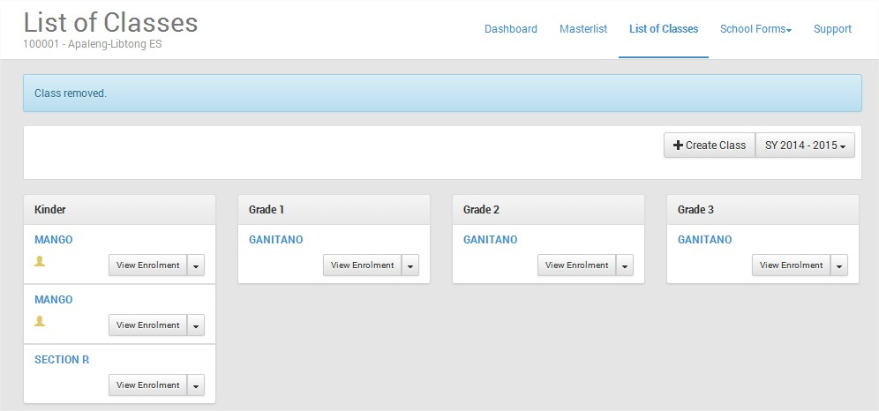
LIS MANUAL MENU
LIS WEBSITE
LOGIN PAGE MENU
MANAGING OF SH ACCOUNT
CHANGE PASSWORD
CHANGE USERNAME
MANAGING PERSONNEL
ADD PERSONNEL ACCOUNT
REMOVE ACCOUNT
LOCK/DISABLE ACCOUNT
RESET PASSWORD
GUIDELINE FOR BOSY UPDATING
LEARNER INFORMATION SYSTEM
CREATE CLASSES
REMOVE CLASS
SET ADVISER/ADD PERSONNEL ACCOUNT
ENROLMENT OF LEARNER
ENROL LEARNER W/O LRN
BATCH ENROL OF LEARNER
ENROL TRANSFEREES (By LRN and By NAME)
PROFILE OF LEARNER
UPDATING OF PROFILE/UN-ENROL
SCHOOL FORMS
PLEASE READ

Slide 34
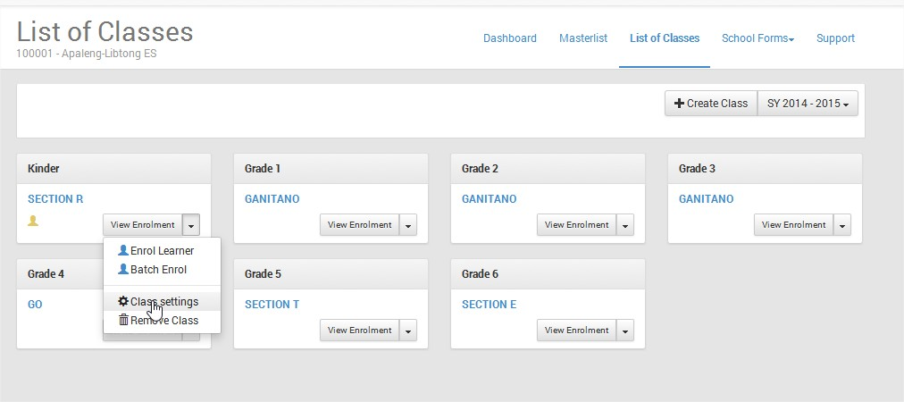
LIS MANUAL MENU
LIS WEBSITE
LOGIN PAGE MENU
MANAGING OF SH ACCOUNT
CHANGE PASSWORD
CHANGE USERNAME
MANAGING PERSONNEL
ADD PERSONNEL ACCOUNT
REMOVE ACCOUNT
LOCK/DISABLE ACCOUNT
RESET PASSWORD
GUIDELINE FOR BOSY UPDATING
LEARNER INFORMATION SYSTEM
CREATE CLASSES
REMOVE CLASS
SET ADVISER/ADD PERSONNEL ACCOUNT
ENROLMENT OF LEARNER
ENROL LEARNER W/O LRN
BATCH ENROL OF LEARNER
ENROL TRANSFEREES (By LRN and By NAME)
PROFILE OF LEARNER
UPDATING OF PROFILE/UN-ENROL
SCHOOL FORMS
SET CLASS ADVISER IN A SECTION / ADD PERSONNEL
Dropdown List
Select a section to set an adviser, click the dropdownlist, Click Class Settings

Slide 35
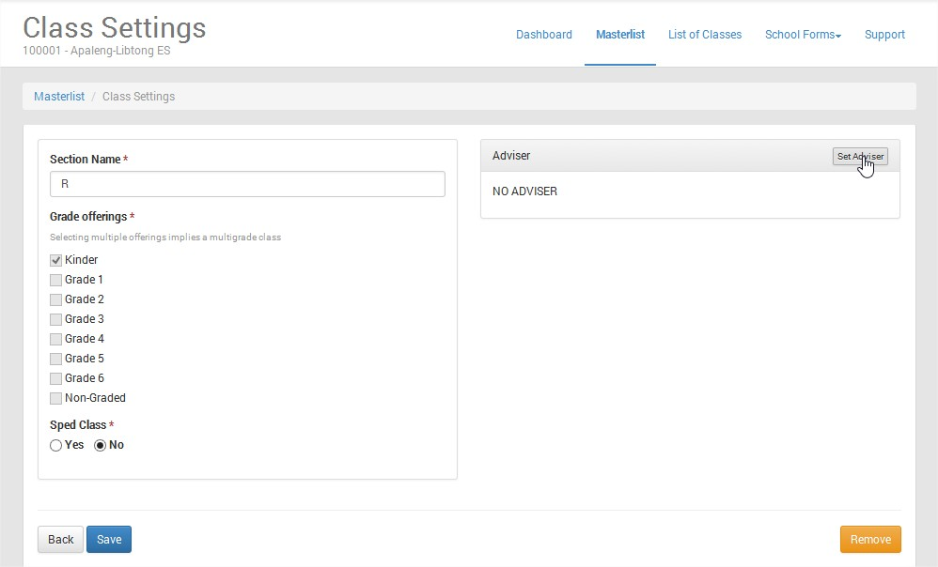
LIS MANUAL MENU
LIS WEBSITE
LOGIN PAGE MENU
MANAGING OF SH ACCOUNT
CHANGE PASSWORD
CHANGE USERNAME
MANAGING PERSONNEL
ADD PERSONNEL ACCOUNT
REMOVE ACCOUNT
LOCK/DISABLE ACCOUNT
RESET PASSWORD
GUIDELINE FOR BOSY UPDATING
LEARNER INFORMATION SYSTEM
CREATE CLASSES
REMOVE CLASS
SET ADVISER/ADD PERSONNEL ACCOUNT
ENROLMENT OF LEARNER
ENROL LEARNER W/O LRN
BATCH ENROL OF LEARNER
ENROL TRANSFEREES (By LRN and By NAME)
PROFILE OF LEARNER
UPDATING OF PROFILE/UN-ENROL
SCHOOL FORMS
Click Set Adviser

Slide 36
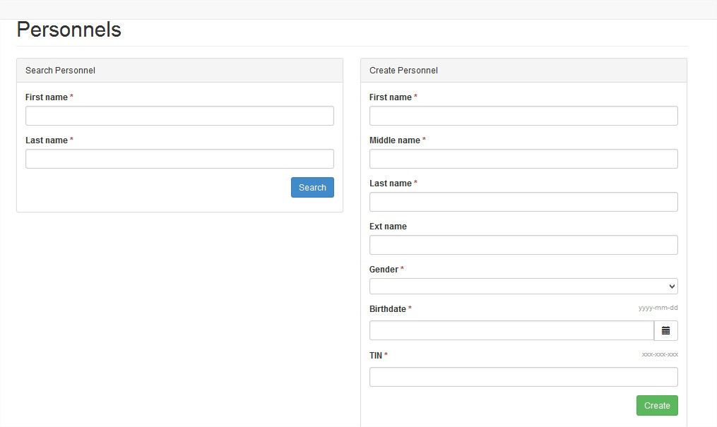
LIS MANUAL MENU
LIS WEBSITE
LOGIN PAGE MENU
MANAGING OF SH ACCOUNT
CHANGE PASSWORD
CHANGE USERNAME
MANAGING PERSONNEL
ADD PERSONNEL ACCOUNT
REMOVE ACCOUNT
LOCK/DISABLE ACCOUNT
RESET PASSWORD
GUIDELINE FOR BOSY UPDATING
LEARNER INFORMATION SYSTEM
CREATE CLASSES
REMOVE CLASS
SET ADVISER/ADD PERSONNEL ACCOUNT
ENROLMENT OF LEARNER
ENROL LEARNER W/O LRN
BATCH ENROL OF LEARNER
ENROL TRANSFEREES (By LRN and By NAME)
PROFILE OF LEARNER
UPDATING OF PROFILE/UN-ENROL
SCHOOL FORMS
USE THIS IF YOU HAVE EXISTING PERSONNEL, JUST TYPE THE FIRSTNAME AND LASTNAME THEN CLICK SEARCH
USE THIS IF YOU WANT TO CREATE A NEW PERSONNEL/ADVISER, FILL UP THE REQUIRED DATA, THEN CLICK CREATE

Slide 37
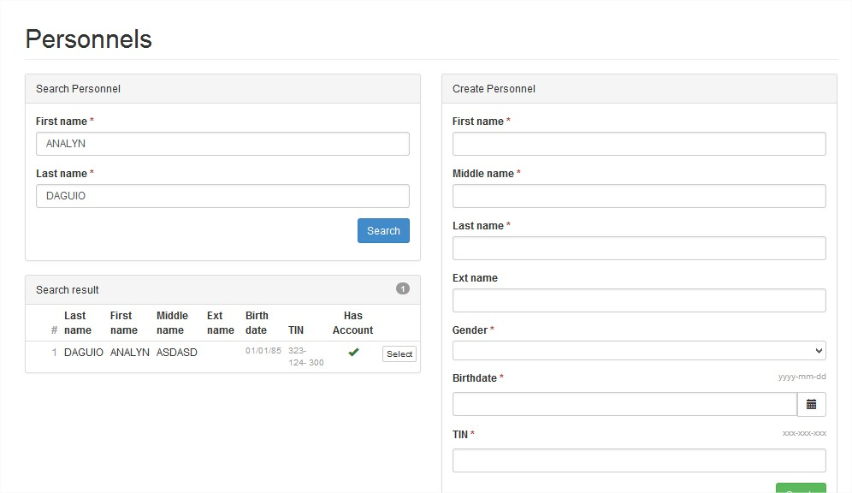
LIS MANUAL MENU
LIS WEBSITE
LOGIN PAGE MENU
MANAGING OF SH ACCOUNT
CHANGE PASSWORD
CHANGE USERNAME
MANAGING PERSONNEL
ADD PERSONNEL ACCOUNT
REMOVE ACCOUNT
LOCK/DISABLE ACCOUNT
RESET PASSWORD
GUIDELINE FOR BOSY UPDATING
LEARNER INFORMATION SYSTEM
CREATE CLASSES
REMOVE CLASS
SET ADVISER/ADD PERSONNEL ACCOUNT
ENROLMENT OF LEARNER
ENROL LEARNER W/O LRN
BATCH ENROL OF LEARNER
ENROL TRANSFEREES (By LRN and By NAME)
PROFILE OF LEARNER
UPDATING OF PROFILE/UN-ENROL
SCHOOL FORMS
Click Select

Slide 38
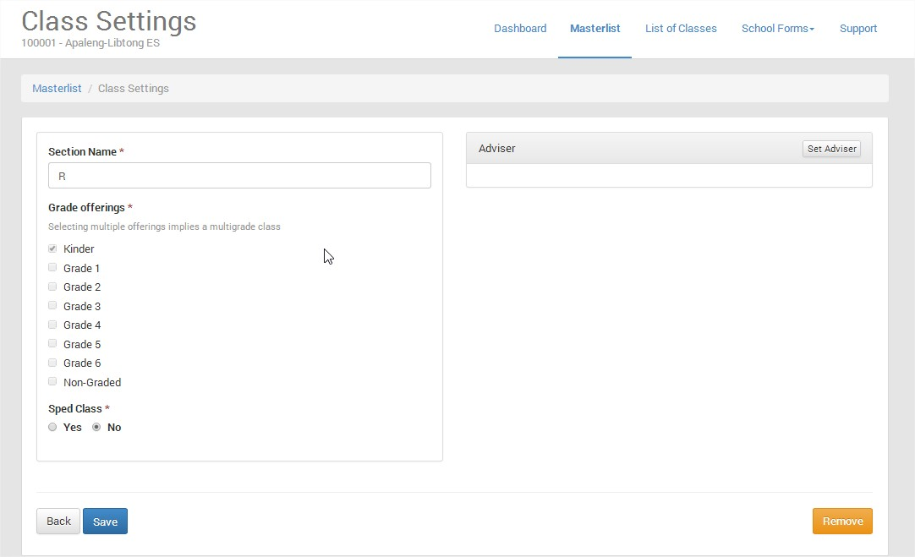
LIS MANUAL MENU
LIS WEBSITE
LOGIN PAGE MENU
MANAGING OF SH ACCOUNT
CHANGE PASSWORD
CHANGE USERNAME
MANAGING PERSONNEL
ADD PERSONNEL ACCOUNT
REMOVE ACCOUNT
LOCK/DISABLE ACCOUNT
RESET PASSWORD
GUIDELINE FOR BOSY UPDATING
LEARNER INFORMATION SYSTEM
CREATE CLASSES
REMOVE CLASS
SET ADVISER/ADD PERSONNEL ACCOUNT
ENROLMENT OF LEARNER
ENROL LEARNER W/O LRN
BATCH ENROL OF LEARNER
ENROL TRANSFEREES (By LRN and By NAME)
PROFILE OF LEARNER
UPDATING OF PROFILE/UN-ENROL
SCHOOL FORMS
Analyn Daguio
Click Save to save changes

Slide 39
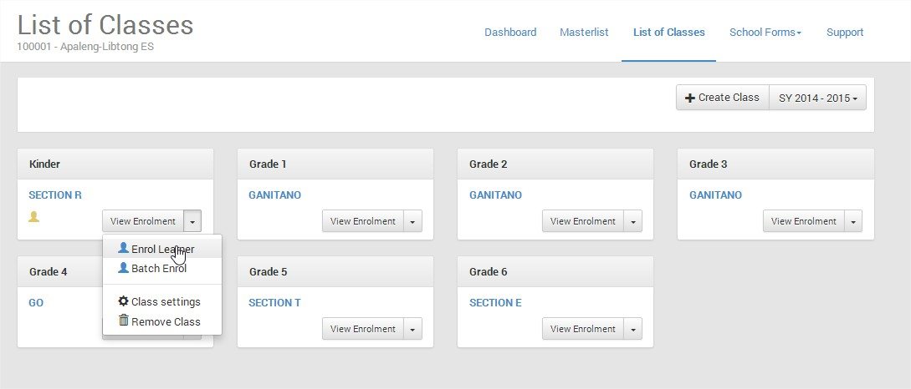
LIS MANUAL MENU
LIS WEBSITE
LOGIN PAGE MENU
MANAGING OF SH ACCOUNT
CHANGE PASSWORD
CHANGE USERNAME
MANAGING PERSONNEL
ADD PERSONNEL ACCOUNT
REMOVE ACCOUNT
LOCK/DISABLE ACCOUNT
RESET PASSWORD
GUIDELINE FOR BOSY UPDATING
LEARNER INFORMATION SYSTEM
CREATE CLASSES
REMOVE CLASS
SET ADVISER/ADD PERSONNEL ACCOUNT
ENROLMENT OF LEARNER
ENROL LEARNER W/O LRN
BATCH ENROL OF LEARNER
ENROL TRANSFEREES (By LRN and By NAME)
PROFILE OF LEARNER
UPDATING OF PROFILE/UN-ENROL
SCHOOL FORMS
ENROLLING LEARNER WITHOUT LRN (KINDERGARTEN OR TRANSFEREES FROM PRIVATE)
SELECT A SECTION WHERE YOU WANT TO ENROL A PUPIL WITHOUT LRN, SAY KINDER, CLICK THE DROPDOWN LIST, THEN SELECT ENROL LEARNER

Slide 40
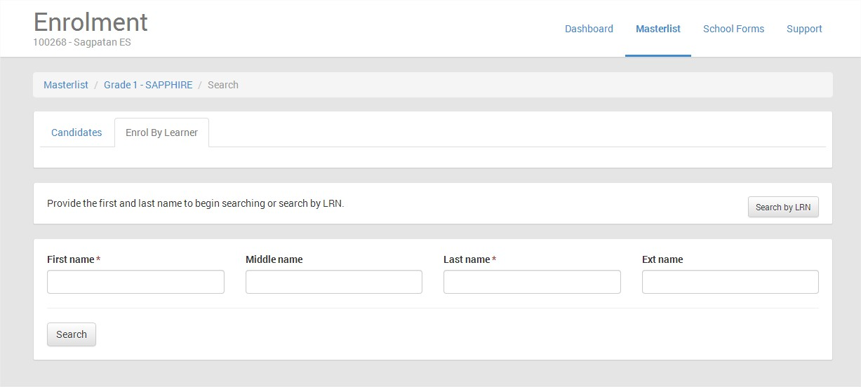
LIS MANUAL MENU
LIS WEBSITE
LOGIN PAGE MENU
MANAGING OF SH ACCOUNT
CHANGE PASSWORD
CHANGE USERNAME
MANAGING PERSONNEL
ADD PERSONNEL ACCOUNT
REMOVE ACCOUNT
LOCK/DISABLE ACCOUNT
RESET PASSWORD
GUIDELINE FOR BOSY UPDATING
LEARNER INFORMATION SYSTEM
CREATE CLASSES
REMOVE CLASS
SET ADVISER/ADD PERSONNEL ACCOUNT
ENROLMENT OF LEARNER
ENROL LEARNER W/O LRN
BATCH ENROL OF LEARNER
ENROL TRANSFEREES (By LRN and By NAME)
PROFILE OF LEARNER
UPDATING OF PROFILE/UN-ENROL
SCHOOL FORMS
TYPE THE FIRSTNAME AND LASTNAME THEN CLICK SEARCH

Slide 41
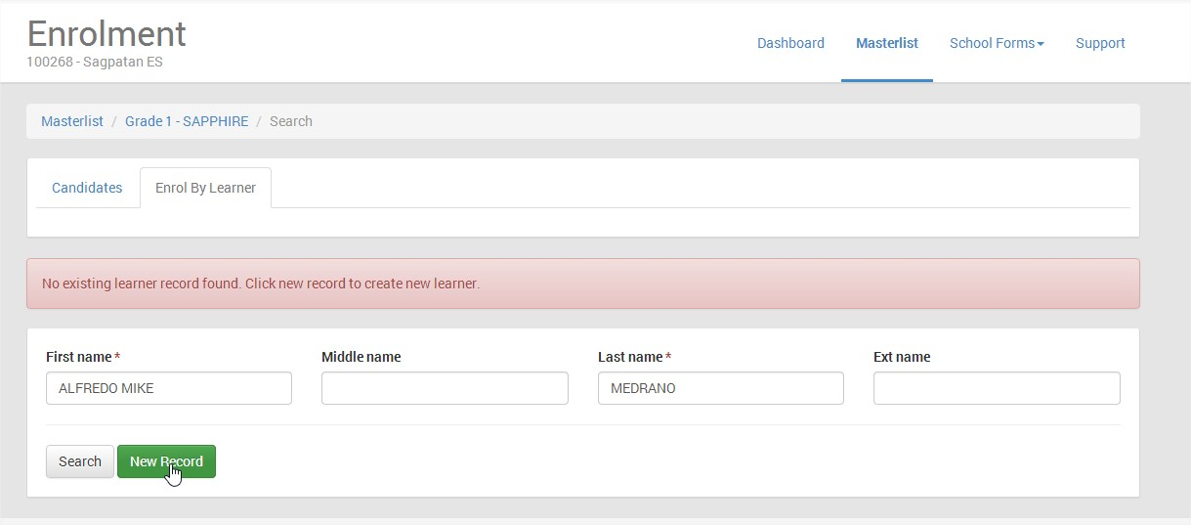
LIS MANUAL MENU
LIS WEBSITE
LOGIN PAGE MENU
MANAGING OF SH ACCOUNT
CHANGE PASSWORD
CHANGE USERNAME
MANAGING PERSONNEL
ADD PERSONNEL ACCOUNT
REMOVE ACCOUNT
LOCK/DISABLE ACCOUNT
RESET PASSWORD
GUIDELINE FOR BOSY UPDATING
LEARNER INFORMATION SYSTEM
CREATE CLASSES
REMOVE CLASS
SET ADVISER/ADD PERSONNEL ACCOUNT
ENROLMENT OF LEARNER
ENROL LEARNER W/O LRN
BATCH ENROL OF LEARNER
ENROL TRANSFEREES (By LRN and By NAME)
PROFILE OF LEARNER
UPDATING OF PROFILE/UN-ENROL
SCHOOL FORMS
CLICK NEW RECORD

Slide 42
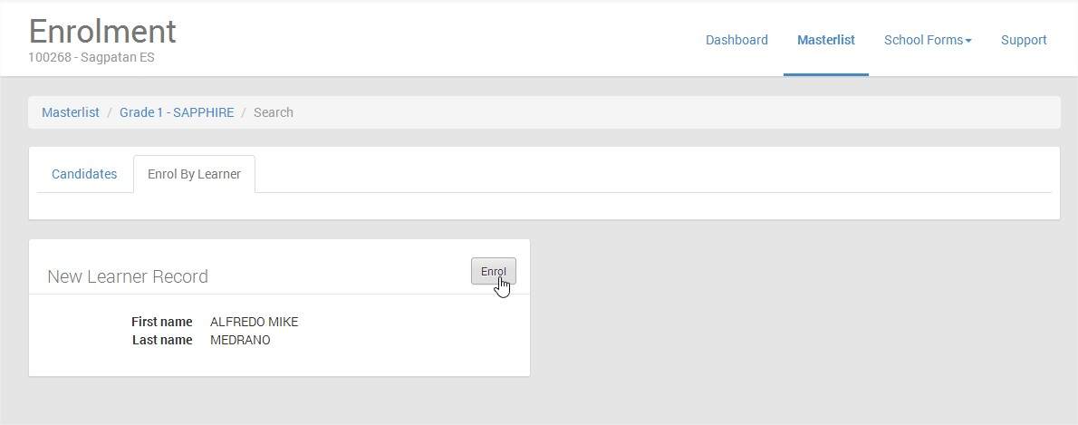
LIS MANUAL MENU
LIS WEBSITE
LOGIN PAGE MENU
MANAGING OF SH ACCOUNT
CHANGE PASSWORD
CHANGE USERNAME
MANAGING PERSONNEL
ADD PERSONNEL ACCOUNT
REMOVE ACCOUNT
LOCK/DISABLE ACCOUNT
RESET PASSWORD
GUIDELINE FOR BOSY UPDATING
LEARNER INFORMATION SYSTEM
CREATE CLASSES
REMOVE CLASS
SET ADVISER/ADD PERSONNEL ACCOUNT
ENROLMENT OF LEARNER
ENROL LEARNER W/O LRN
BATCH ENROL OF LEARNER
ENROL TRANSFEREES (By LRN and By NAME)
PROFILE OF LEARNER
UPDATING OF PROFILE/UN-ENROL
SCHOOL FORMS
CLICK ENROL

Slide 43
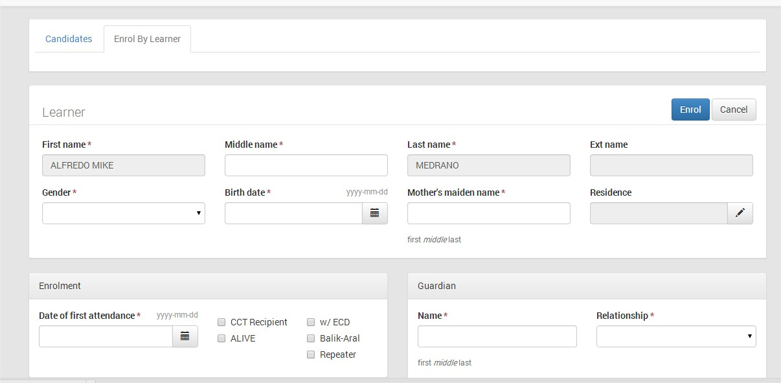
LIS MANUAL MENU
LIS WEBSITE
LOGIN PAGE MENU
MANAGING OF SH ACCOUNT
CHANGE PASSWORD
CHANGE USERNAME
MANAGING PERSONNEL
ADD PERSONNEL ACCOUNT
REMOVE ACCOUNT
LOCK/DISABLE ACCOUNT
RESET PASSWORD
GUIDELINE FOR BOSY UPDATING
LEARNER INFORMATION SYSTEM
CREATE CLASSES
REMOVE CLASS
SET ADVISER/ADD PERSONNEL ACCOUNT
ENROLMENT OF LEARNER
ENROL LEARNER W/O LRN
BATCH ENROL OF LEARNER
ENROL TRANSFEREES (By LRN and By NAME)
PROFILE OF LEARNER
UPDATING OF PROFILE/UN-ENROL
SCHOOL FORMS
Fill up the required data!
Click here to indicate the Date of First Attendance
Click the box beside CCT Recipient if the learner is 4Ps, Click the box - Alive if Muslim, Click the box if Balik Aral, with ECD or Repeater

Slide 44
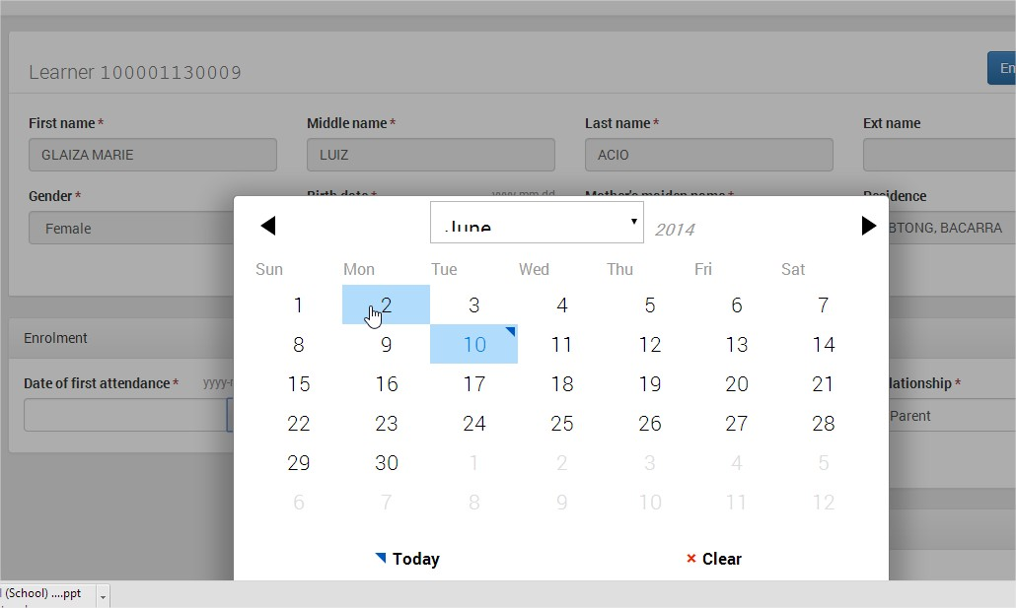
LIS MANUAL MENU
LIS WEBSITE
LOGIN PAGE MENU
MANAGING OF SH ACCOUNT
CHANGE PASSWORD
CHANGE USERNAME
MANAGING PERSONNEL
ADD PERSONNEL ACCOUNT
REMOVE ACCOUNT
LOCK/DISABLE ACCOUNT
RESET PASSWORD
GUIDELINE FOR BOSY UPDATING
LEARNER INFORMATION SYSTEM
CREATE CLASSES
REMOVE CLASS
SET ADVISER/ADD PERSONNEL ACCOUNT
ENROLMENT OF LEARNER
ENROL LEARNER W/O LRN
BATCH ENROL OF LEARNER
ENROL TRANSFEREES (By LRN and By NAME)
PROFILE OF LEARNER
UPDATING OF PROFILE/UN-ENROL
SCHOOL FORMS
SELECT THE DATE OF FIRST APPEARANCE OF PUPIL IN THE SCHOOL

Slide 45
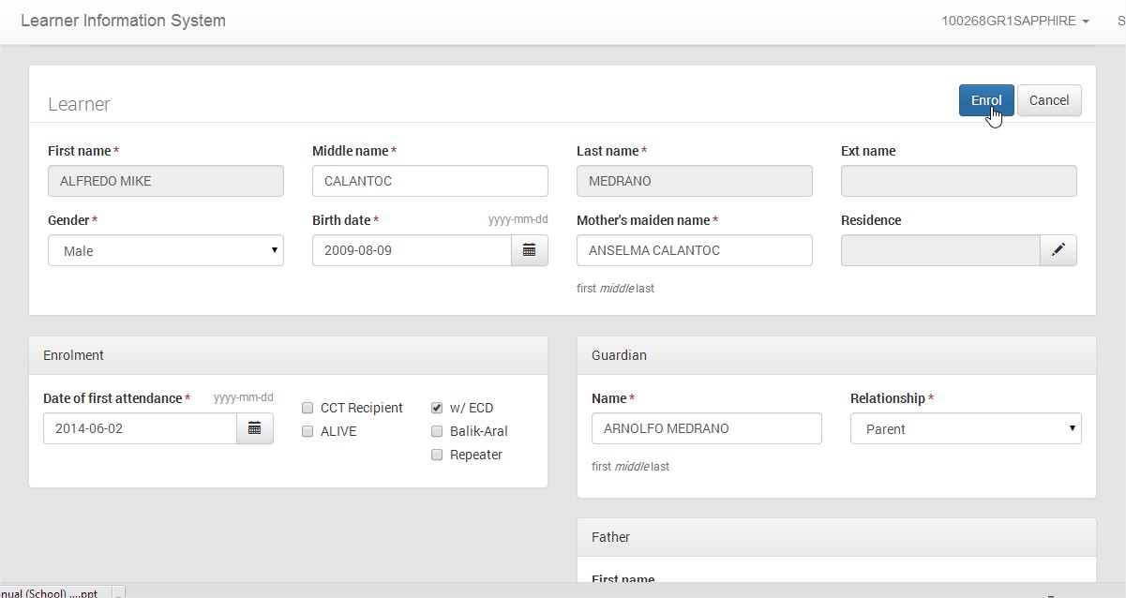
LIS MANUAL MENU
LIS WEBSITE
LOGIN PAGE MENU
MANAGING OF SH ACCOUNT
CHANGE PASSWORD
CHANGE USERNAME
MANAGING PERSONNEL
ADD PERSONNEL ACCOUNT
REMOVE ACCOUNT
LOCK/DISABLE ACCOUNT
RESET PASSWORD
GUIDELINE FOR BOSY UPDATING
LEARNER INFORMATION SYSTEM
CREATE CLASSES
REMOVE CLASS
SET ADVISER/ADD PERSONNEL ACCOUNT
ENROLMENT OF LEARNER
ENROL LEARNER W/O LRN
BATCH ENROL OF LEARNER
ENROL TRANSFEREES (By LRN and By NAME)
PROFILE OF LEARNER
UPDATING OF PROFILE/UN-ENROL
SCHOOL FORMS
AFTER FILLING UP THE REQUIRED DATA, CLICK ENROL

Slide 46
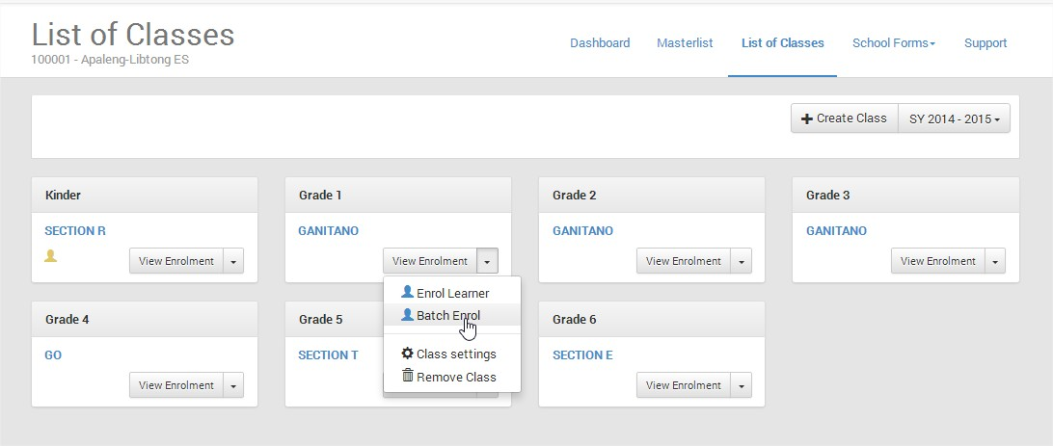
LIS MANUAL MENU
LIS WEBSITE
LOGIN PAGE MENU
MANAGING OF SH ACCOUNT
CHANGE PASSWORD
CHANGE USERNAME
MANAGING PERSONNEL
ADD PERSONNEL ACCOUNT
REMOVE ACCOUNT
LOCK/DISABLE ACCOUNT
RESET PASSWORD
GUIDELINE FOR BOSY UPDATING
LEARNER INFORMATION SYSTEM
CREATE CLASSES
REMOVE CLASS
SET ADVISER/ADD PERSONNEL ACCOUNT
ENROLMENT OF LEARNER
ENROL LEARNER W/O LRN
BATCH ENROL OF LEARNER
ENROL TRANSFEREES (By LRN and By NAME)
PROFILE OF LEARNER
UPDATING OF PROFILE/UN-ENROL
SCHOOL FORMS
ENROLL LEARNER USING BATCH ENROLL
SELECT A GRADE AND SECTION, CLICK THE DROPDOWN LIST, THEN SELECT BATCH ENROL

Slide 47
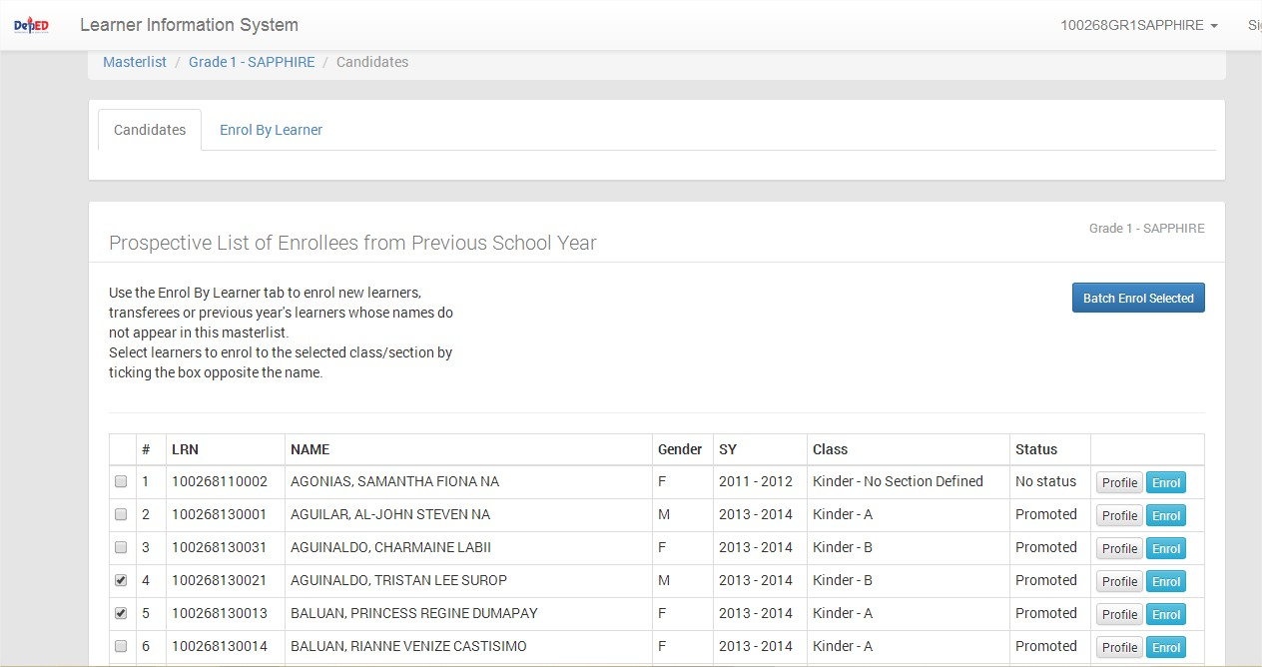
LIS MANUAL MENU
LIS WEBSITE
LOGIN PAGE MENU
MANAGING OF SH ACCOUNT
CHANGE PASSWORD
CHANGE USERNAME
MANAGING PERSONNEL
ADD PERSONNEL ACCOUNT
REMOVE ACCOUNT
LOCK/DISABLE ACCOUNT
RESET PASSWORD
GUIDELINE FOR BOSY UPDATING
LEARNER INFORMATION SYSTEM
CREATE CLASSES
REMOVE CLASS
SET ADVISER/ADD PERSONNEL ACCOUNT
ENROLMENT OF LEARNER
ENROL LEARNER W/O LRN
BATCH ENROL OF LEARNER
ENROL TRANSFEREES (By LRN and By NAME)
PROFILE OF LEARNER
UPDATING OF PROFILE/UN-ENROL
SCHOOL FORMS
Check the box to select the learner to enrol
NOTE: PLEASE SELECT ONLY THOSE LEARNER WITH THE SAME DATE OF FIRST APPEARANCE IN THE SCHOOL

Slide 48
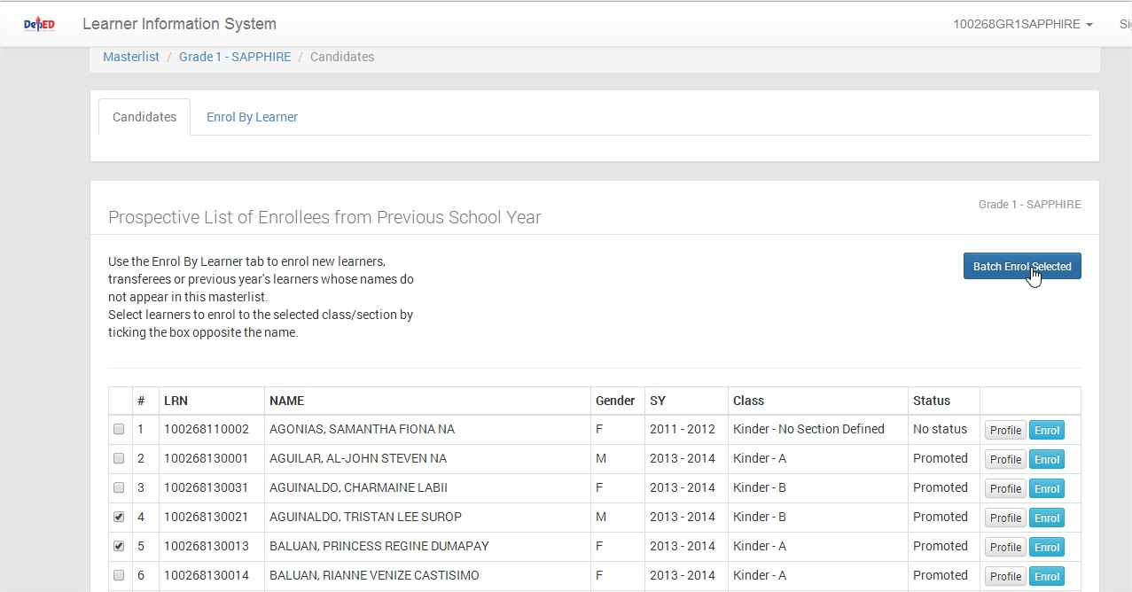
LIS MANUAL MENU
LIS WEBSITE
LOGIN PAGE MENU
MANAGING OF SH ACCOUNT
CHANGE PASSWORD
CHANGE USERNAME
MANAGING PERSONNEL
ADD PERSONNEL ACCOUNT
REMOVE ACCOUNT
LOCK/DISABLE ACCOUNT
RESET PASSWORD
GUIDELINE FOR BOSY UPDATING
LEARNER INFORMATION SYSTEM
CREATE CLASSES
REMOVE CLASS
SET ADVISER/ADD PERSONNEL ACCOUNT
ENROLMENT OF LEARNER
ENROL LEARNER W/O LRN
BATCH ENROL OF LEARNER
ENROL TRANSFEREES (By LRN and By NAME)
PROFILE OF LEARNER
UPDATING OF PROFILE/UN-ENROL
SCHOOL FORMS
AFTER SELECTING THE LEARNER TO ENROL, CLICK BATCH ENROL SELECT

Slide 49
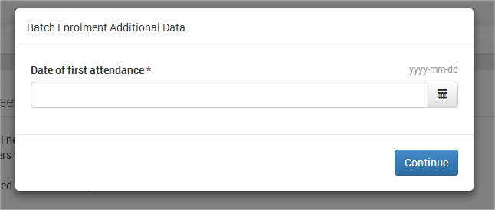
LIS MANUAL MENU
LIS WEBSITE
LOGIN PAGE MENU
MANAGING OF SH ACCOUNT
CHANGE PASSWORD
CHANGE USERNAME
MANAGING PERSONNEL
ADD PERSONNEL ACCOUNT
REMOVE ACCOUNT
LOCK/DISABLE ACCOUNT
RESET PASSWORD
GUIDELINE FOR BOSY UPDATING
LEARNER INFORMATION SYSTEM
CREATE CLASSES
REMOVE CLASS
SET ADVISER/ADD PERSONNEL ACCOUNT
ENROLMENT OF LEARNER
ENROL LEARNER W/O LRN
BATCH ENROL OF LEARNER
ENROL TRANSFEREES (By LRN and By NAME)
PROFILE OF LEARNER
UPDATING OF PROFILE/UN-ENROL
SCHOOL FORMS
Click Here to select Date

Slide 50
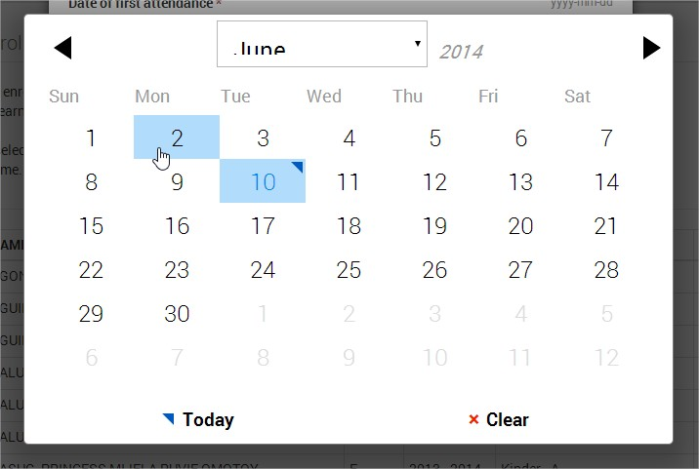
LIS MANUAL MENU
LIS WEBSITE
LOGIN PAGE MENU
MANAGING OF SH ACCOUNT
CHANGE PASSWORD
CHANGE USERNAME
MANAGING PERSONNEL
ADD PERSONNEL ACCOUNT
REMOVE ACCOUNT
LOCK/DISABLE ACCOUNT
RESET PASSWORD
GUIDELINE FOR BOSY UPDATING
LEARNER INFORMATION SYSTEM
CREATE CLASSES
REMOVE CLASS
SET ADVISER/ADD PERSONNEL ACCOUNT
ENROLMENT OF LEARNER
ENROL LEARNER W/O LRN
BATCH ENROL OF LEARNER
ENROL TRANSFEREES (By LRN and By NAME)
PROFILE OF LEARNER
UPDATING OF PROFILE/UN-ENROL
SCHOOL FORMS
CLICK THE DATE OF THE MONTH TO SELECT THE FIRST APPEARANCE IN THE SCHOOL OF THE SELECTED LEARNERS

Slide 51
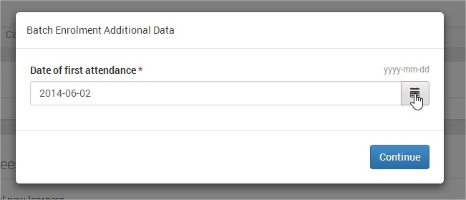
LIS MANUAL MENU
LIS WEBSITE
LOGIN PAGE MENU
MANAGING OF SH ACCOUNT
CHANGE PASSWORD
CHANGE USERNAME
MANAGING PERSONNEL
ADD PERSONNEL ACCOUNT
REMOVE ACCOUNT
LOCK/DISABLE ACCOUNT
RESET PASSWORD
GUIDELINE FOR BOSY UPDATING
LEARNER INFORMATION SYSTEM
CREATE CLASSES
REMOVE CLASS
SET ADVISER/ADD PERSONNEL ACCOUNT
ENROLMENT OF LEARNER
ENROL LEARNER W/O LRN
BATCH ENROL OF LEARNER
ENROL TRANSFEREES (By LRN and By NAME)
PROFILE OF LEARNER
UPDATING OF PROFILE/UN-ENROL
SCHOOL FORMS
CLICK CONTINUE

Slide 52
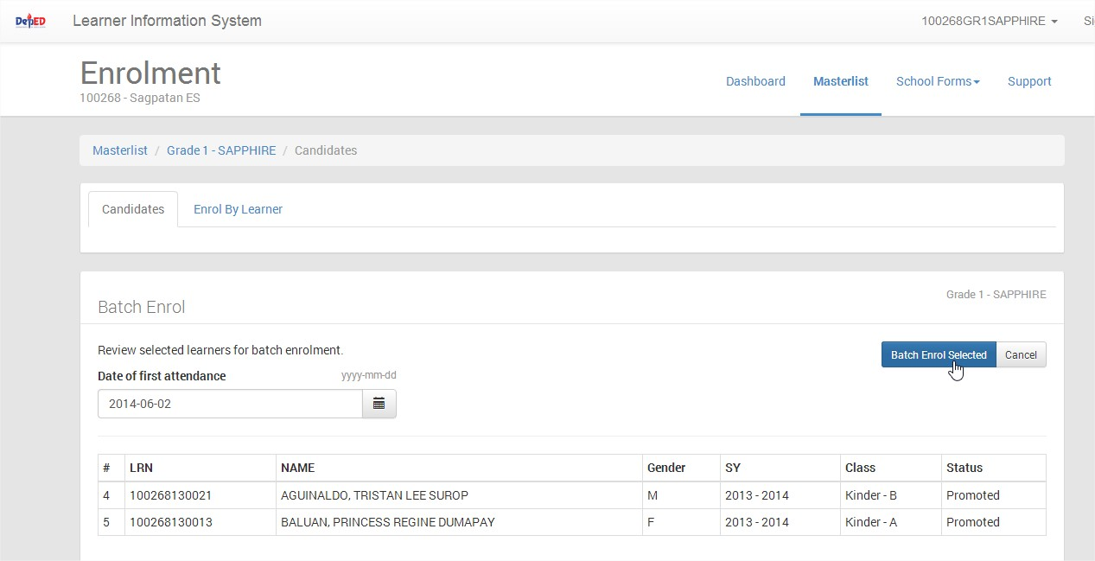
LIS MANUAL MENU
LIS WEBSITE
LOGIN PAGE MENU
MANAGING OF SH ACCOUNT
CHANGE PASSWORD
CHANGE USERNAME
MANAGING PERSONNEL
ADD PERSONNEL ACCOUNT
REMOVE ACCOUNT
LOCK/DISABLE ACCOUNT
RESET PASSWORD
GUIDELINE FOR BOSY UPDATING
LEARNER INFORMATION SYSTEM
CREATE CLASSES
REMOVE CLASS
SET ADVISER/ADD PERSONNEL ACCOUNT
ENROLMENT OF LEARNER
ENROL LEARNER W/O LRN
BATCH ENROL OF LEARNER
ENROL TRANSFEREES (By LRN and By NAME)
PROFILE OF LEARNER
UPDATING OF PROFILE/UN-ENROL
SCHOOL FORMS
List of Classes
REVIEW SELECTED LEARNERS FOR BATCH ENROLL, CLICK CANCEL IF YOU WANT TO CHANGE OR CLICK BATCH ENROL SELECTED IF YOU WANT TO ENROL THEM

Slide 53
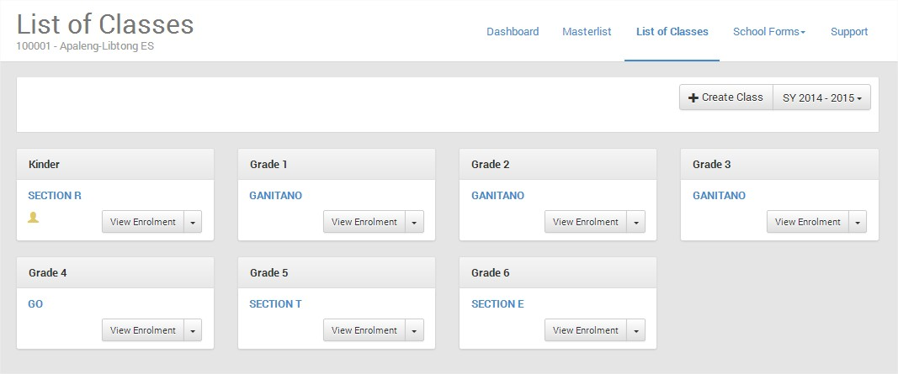
LIS MANUAL MENU
LIS WEBSITE
LOGIN PAGE MENU
MANAGING OF SH ACCOUNT
CHANGE PASSWORD
CHANGE USERNAME
MANAGING PERSONNEL
ADD PERSONNEL ACCOUNT
REMOVE ACCOUNT
LOCK/DISABLE ACCOUNT
RESET PASSWORD
GUIDELINE FOR BOSY UPDATING
LEARNER INFORMATION SYSTEM
CREATE CLASSES
REMOVE CLASS
SET ADVISER/ADD PERSONNEL ACCOUNT
ENROLMENT OF LEARNER
ENROL LEARNER W/O LRN
BATCH ENROL OF LEARNER
ENROL TRANSFEREES (By LRN and By NAME)
PROFILE OF LEARNER
UPDATING OF PROFILE/UN-ENROL
SCHOOL FORMS
2
CLICK LIST OF CLASSES AND CLICK VIEW ENROLMENT TO DISPLAY THE LIST OF PUPILS THIS SY 2014-2015

Slide 54
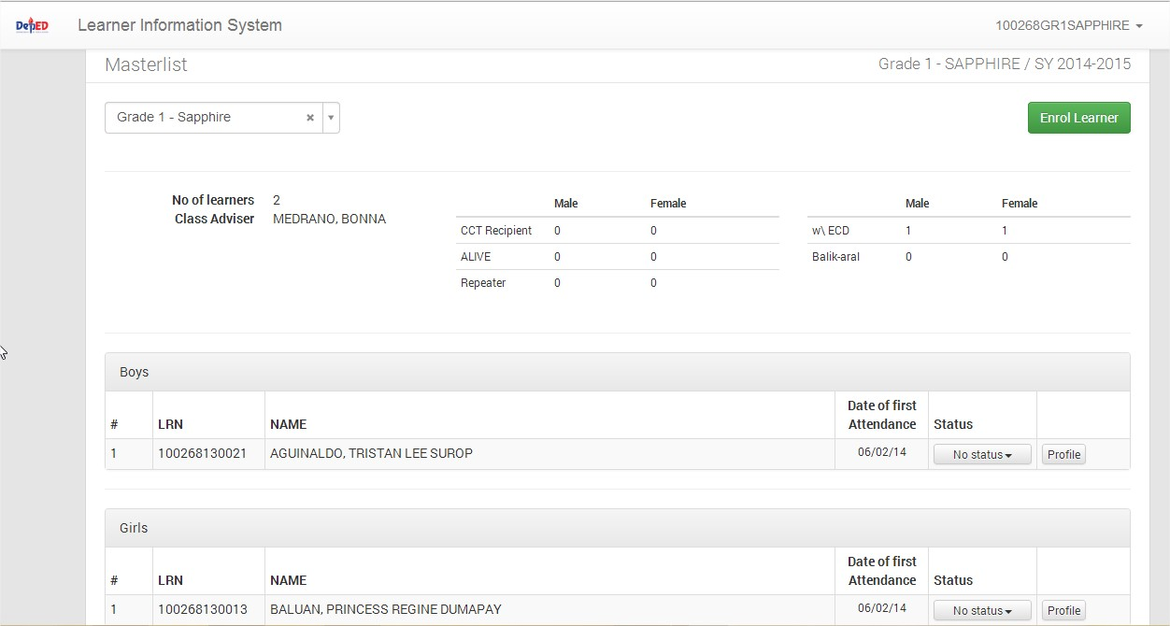
LIS MANUAL MENU
LIS WEBSITE
LOGIN PAGE MENU
MANAGING OF SH ACCOUNT
CHANGE PASSWORD
CHANGE USERNAME
MANAGING PERSONNEL
ADD PERSONNEL ACCOUNT
REMOVE ACCOUNT
LOCK/DISABLE ACCOUNT
RESET PASSWORD
GUIDELINE FOR BOSY UPDATING
LEARNER INFORMATION SYSTEM
CREATE CLASSES
REMOVE CLASS
SET ADVISER/ADD PERSONNEL ACCOUNT
ENROLMENT OF LEARNER
ENROL LEARNER W/O LRN
BATCH ENROL OF LEARNER
ENROL TRANSFEREES (By LRN and By NAME)
PROFILE OF LEARNER
UPDATING OF PROFILE/UN-ENROL
SCHOOL FORMS
YOU HAVE ALREADY 2 LEARNERS ENROLLED IN SY 2014-2015

Slide 55
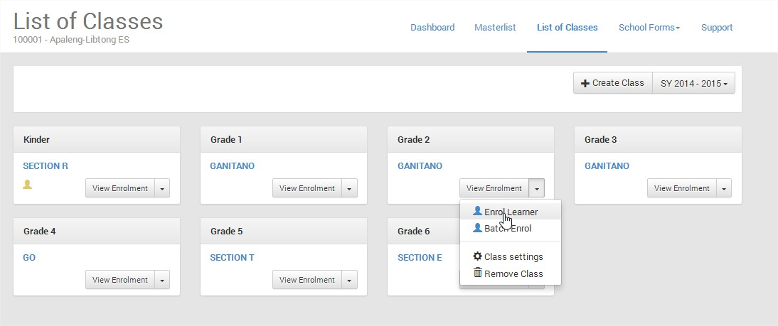
LIS MANUAL MENU
LIS WEBSITE
LOGIN PAGE MENU
MANAGING OF SH ACCOUNT
CHANGE PASSWORD
CHANGE USERNAME
MANAGING PERSONNEL
ADD PERSONNEL ACCOUNT
REMOVE ACCOUNT
LOCK/DISABLE ACCOUNT
RESET PASSWORD
GUIDELINE FOR BOSY UPDATING
LEARNER INFORMATION SYSTEM
CREATE CLASSES
REMOVE CLASS
SET ADVISER/ADD PERSONNEL ACCOUNT
ENROLMENT OF LEARNER
ENROL LEARNER W/O LRN
BATCH ENROL OF LEARNER
ENROL TRANSFEREES (By LRN and By NAME)
PROFILE OF LEARNER
UPDATING OF PROFILE/UN-ENROL
SCHOOL FORMS
ENROLLING TRANSFEREES
SELECT A GRADE AND SECTION TO ENROL TRANSFEREE, CLICK DROPDOWN LIST, SELECT ENROL LEARNER

Slide 56
LIS MANUAL MENU
LIS WEBSITE
LOGIN PAGE MENU
MANAGING OF SH ACCOUNT
CHANGE PASSWORD
CHANGE USERNAME
MANAGING PERSONNEL
ADD PERSONNEL ACCOUNT
REMOVE ACCOUNT
LOCK/DISABLE ACCOUNT
RESET PASSWORD
GUIDELINE FOR BOSY UPDATING
LEARNER INFORMATION SYSTEM
CREATE CLASSES
REMOVE CLASS
SET ADVISER/ADD PERSONNEL ACCOUNT
ENROLMENT OF LEARNER
ENROL LEARNER W/O LRN
BATCH ENROL OF LEARNER
ENROL TRANSFEREES (By LRN and By NAME)
PROFILE OF LEARNER
UPDATING OF PROFILE/UN-ENROL
SCHOOL FORMS
SEARCH BY LRN
Click SEARCH BY LRN

Slide 57
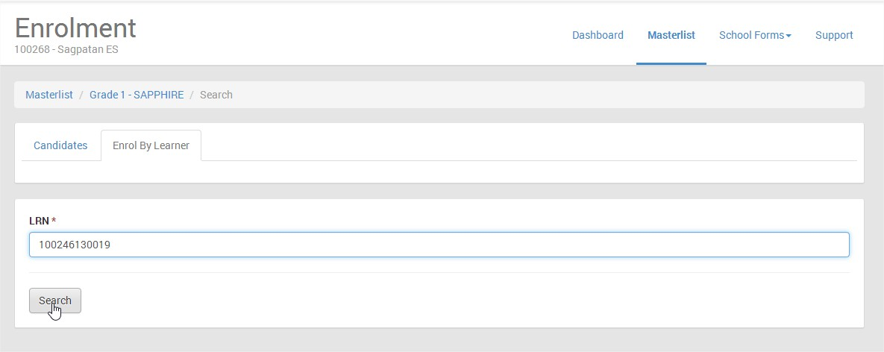
LIS MANUAL MENU
LIS WEBSITE
LOGIN PAGE MENU
MANAGING OF SH ACCOUNT
CHANGE PASSWORD
CHANGE USERNAME
MANAGING PERSONNEL
ADD PERSONNEL ACCOUNT
REMOVE ACCOUNT
LOCK/DISABLE ACCOUNT
RESET PASSWORD
GUIDELINE FOR BOSY UPDATING
LEARNER INFORMATION SYSTEM
CREATE CLASSES
REMOVE CLASS
SET ADVISER/ADD PERSONNEL ACCOUNT
ENROLMENT OF LEARNER
ENROL LEARNER W/O LRN
BATCH ENROL OF LEARNER
ENROL TRANSFEREES (By LRN and By NAME)
PROFILE OF LEARNER
UPDATING OF PROFILE/UN-ENROL
SCHOOL FORMS
TYPE THE LRN NUMBER THEN CLICK SEARCH

Slide 58
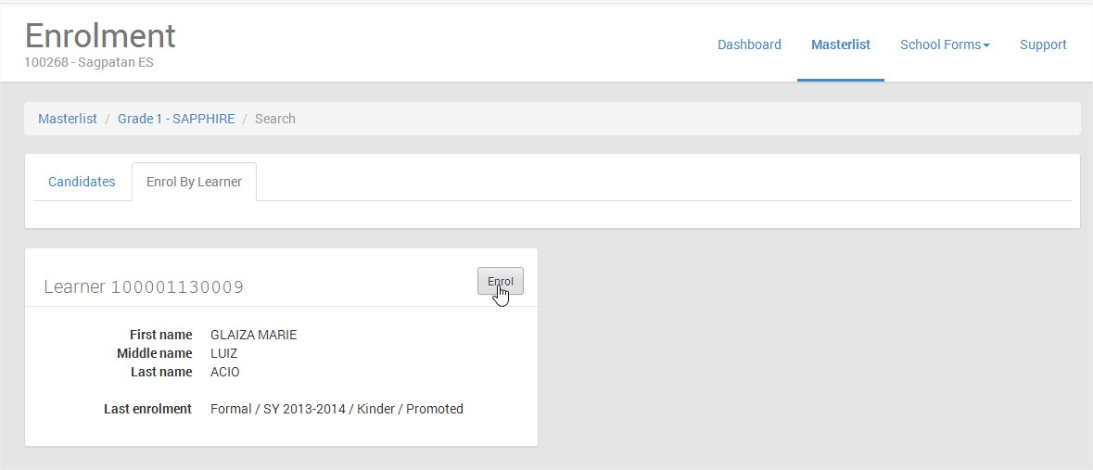
LIS MANUAL MENU
LIS WEBSITE
LOGIN PAGE MENU
MANAGING OF SH ACCOUNT
CHANGE PASSWORD
CHANGE USERNAME
MANAGING PERSONNEL
ADD PERSONNEL ACCOUNT
REMOVE ACCOUNT
LOCK/DISABLE ACCOUNT
RESET PASSWORD
GUIDELINE FOR BOSY UPDATING
LEARNER INFORMATION SYSTEM
CREATE CLASSES
REMOVE CLASS
SET ADVISER/ADD PERSONNEL ACCOUNT
ENROLMENT OF LEARNER
ENROL LEARNER W/O LRN
BATCH ENROL OF LEARNER
ENROL TRANSFEREES (By LRN and By NAME)
PROFILE OF LEARNER
UPDATING OF PROFILE/UN-ENROL
SCHOOL FORMS
Use the Override Facility if it is not eligible, Do you want to override this information and proceed, Click Yes to Continue
CLICK ENROL

Slide 59
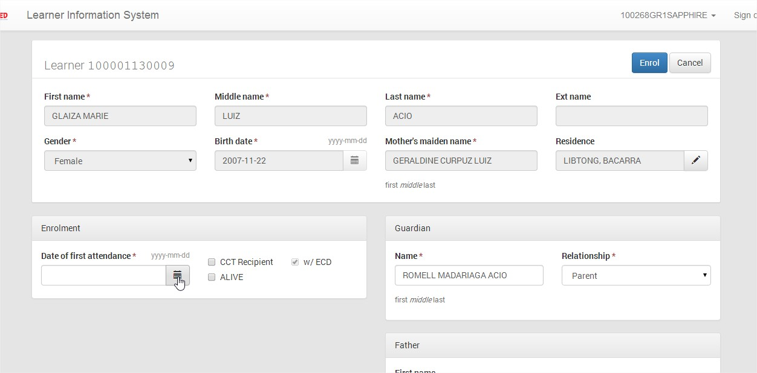
LIS MANUAL MENU
LIS WEBSITE
LOGIN PAGE MENU
MANAGING OF SH ACCOUNT
CHANGE PASSWORD
CHANGE USERNAME
MANAGING PERSONNEL
ADD PERSONNEL ACCOUNT
REMOVE ACCOUNT
LOCK/DISABLE ACCOUNT
RESET PASSWORD
GUIDELINE FOR BOSY UPDATING
LEARNER INFORMATION SYSTEM
CREATE CLASSES
REMOVE CLASS
SET ADVISER/ADD PERSONNEL ACCOUNT
ENROLMENT OF LEARNER
ENROL LEARNER W/O LRN
BATCH ENROL OF LEARNER
ENROL TRANSFEREES (By LRN and By NAME)
PROFILE OF LEARNER
UPDATING OF PROFILE/UN-ENROL
SCHOOL FORMS
Click here to indicate the Date of First Attendance
Click the box beside CCT Recipient if the learner is 4Ps, Click the box - Alive if Muslim, Click the box if Balik Aral, with ECD or Repeater

Slide 60
LIS MANUAL MENU
LIS WEBSITE
LOGIN PAGE MENU
MANAGING OF SH ACCOUNT
CHANGE PASSWORD
CHANGE USERNAME
MANAGING PERSONNEL
ADD PERSONNEL ACCOUNT
REMOVE ACCOUNT
LOCK/DISABLE ACCOUNT
RESET PASSWORD
GUIDELINE FOR BOSY UPDATING
LEARNER INFORMATION SYSTEM
CREATE CLASSES
REMOVE CLASS
SET ADVISER/ADD PERSONNEL ACCOUNT
ENROLMENT OF LEARNER
ENROL LEARNER W/O LRN
BATCH ENROL OF LEARNER
ENROL TRANSFEREES (By LRN and By NAME)
PROFILE OF LEARNER
UPDATING OF PROFILE/UN-ENROL
SCHOOL FORMS
CLICK THE DATE OF THE MONTH TO SELECT THE FIRST APPEARANCE IN THE SCHOOL OF THE SELECTED LEARNERS

Slide 61
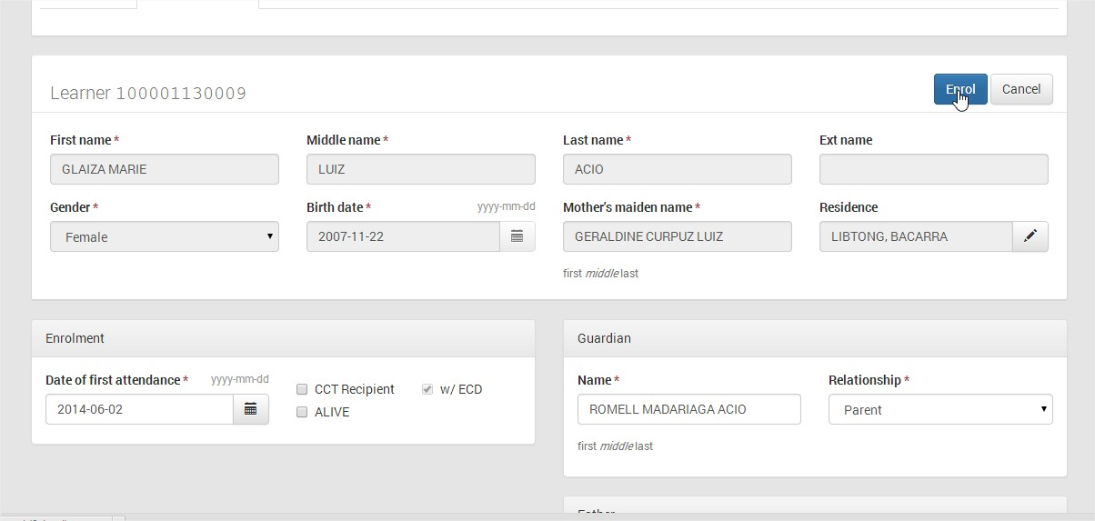
LIS MANUAL MENU
LIS WEBSITE
LOGIN PAGE MENU
MANAGING OF SH ACCOUNT
CHANGE PASSWORD
CHANGE USERNAME
MANAGING PERSONNEL
ADD PERSONNEL ACCOUNT
REMOVE ACCOUNT
LOCK/DISABLE ACCOUNT
RESET PASSWORD
GUIDELINE FOR BOSY UPDATING
LEARNER INFORMATION SYSTEM
CREATE CLASSES
REMOVE CLASS
SET ADVISER/ADD PERSONNEL ACCOUNT
ENROLMENT OF LEARNER
ENROL LEARNER W/O LRN
BATCH ENROL OF LEARNER
ENROL TRANSFEREES (By LRN and By NAME)
PROFILE OF LEARNER
UPDATING OF PROFILE/UN-ENROL
SCHOOL FORMS
AFTER FILLING UP THE REQUIRED DATA, CLICK ENROL

Slide 62
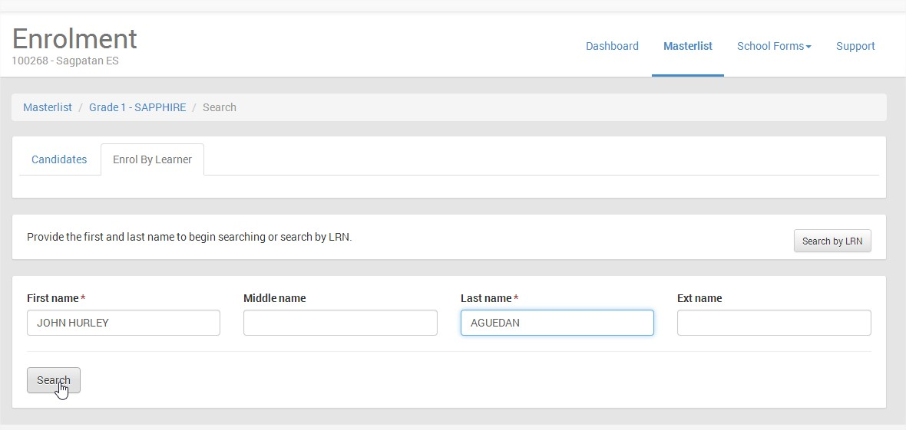
LIS MANUAL MENU
LIS WEBSITE
LOGIN PAGE MENU
MANAGING OF SH ACCOUNT
CHANGE PASSWORD
CHANGE USERNAME
MANAGING PERSONNEL
ADD PERSONNEL ACCOUNT
REMOVE ACCOUNT
LOCK/DISABLE ACCOUNT
RESET PASSWORD
GUIDELINE FOR BOSY UPDATING
LEARNER INFORMATION SYSTEM
CREATE CLASSES
REMOVE CLASS
SET ADVISER/ADD PERSONNEL ACCOUNT
ENROLMENT OF LEARNER
ENROL LEARNER W/O LRN
BATCH ENROL OF LEARNER
ENROL TRANSFEREES (By LRN and By NAME)
PROFILE OF LEARNER
UPDATING OF PROFILE/UN-ENROL
SCHOOL FORMS
ENROL BY NAME
TYPE THE FIRST NAME AND LAST NAME, THEN CLICK SEARCH

Slide 63
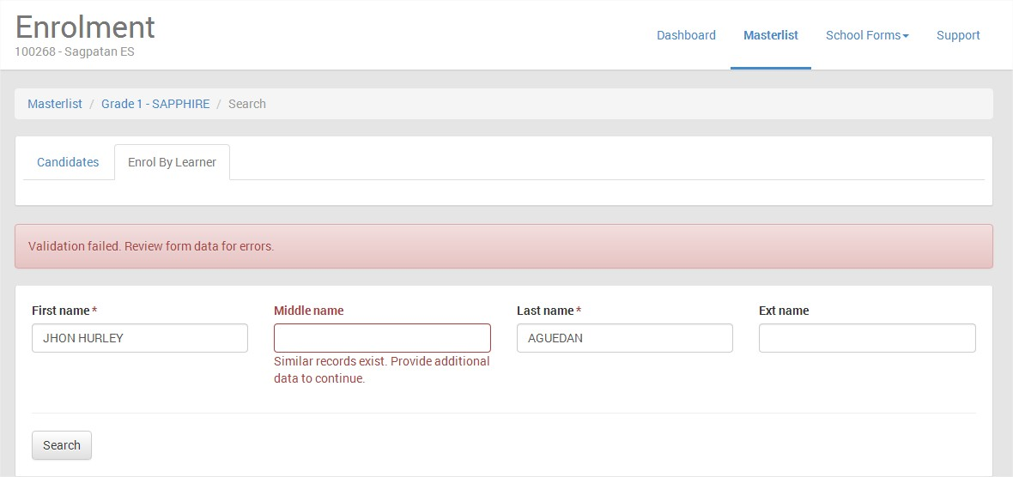
LIS MANUAL MENU
LIS WEBSITE
LOGIN PAGE MENU
MANAGING OF SH ACCOUNT
CHANGE PASSWORD
CHANGE USERNAME
MANAGING PERSONNEL
ADD PERSONNEL ACCOUNT
REMOVE ACCOUNT
LOCK/DISABLE ACCOUNT
RESET PASSWORD
GUIDELINE FOR BOSY UPDATING
LEARNER INFORMATION SYSTEM
CREATE CLASSES
REMOVE CLASS
SET ADVISER/ADD PERSONNEL ACCOUNT
ENROLMENT OF LEARNER
ENROL LEARNER W/O LRN
BATCH ENROL OF LEARNER
ENROL TRANSFEREES (By LRN and By NAME)
PROFILE OF LEARNER
UPDATING OF PROFILE/UN-ENROL
SCHOOL FORMS
IF SIMILAR RECORD EXIST, PROVIDE THE MIDDLE NAME THEN CLICK SEARCH

Slide 64
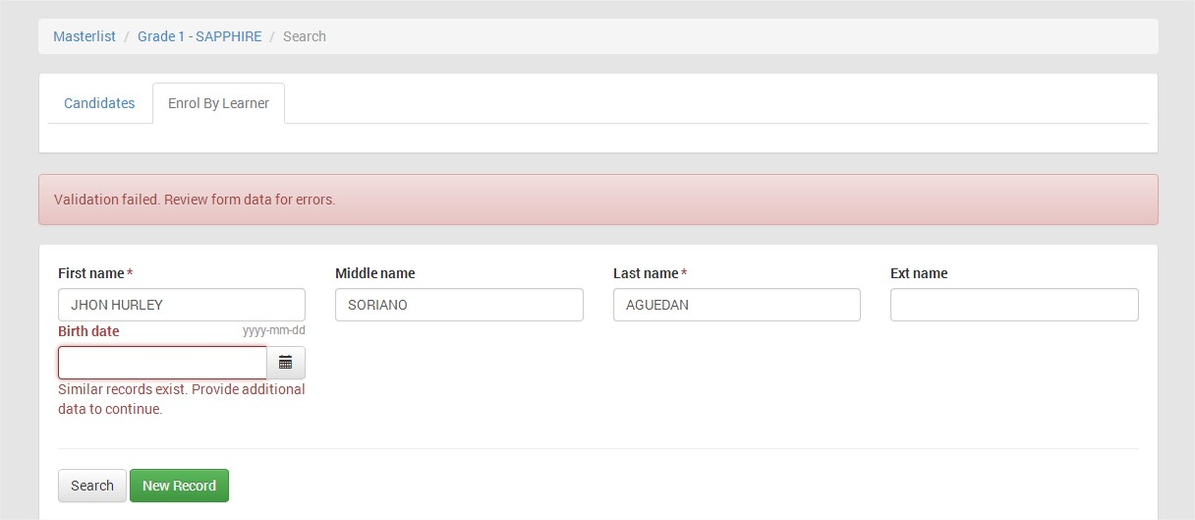
LIS MANUAL MENU
LIS WEBSITE
LOGIN PAGE MENU
MANAGING OF SH ACCOUNT
CHANGE PASSWORD
CHANGE USERNAME
MANAGING PERSONNEL
ADD PERSONNEL ACCOUNT
REMOVE ACCOUNT
LOCK/DISABLE ACCOUNT
RESET PASSWORD
GUIDELINE FOR BOSY UPDATING
LEARNER INFORMATION SYSTEM
CREATE CLASSES
REMOVE CLASS
SET ADVISER/ADD PERSONNEL ACCOUNT
ENROLMENT OF LEARNER
ENROL LEARNER W/O LRN
BATCH ENROL OF LEARNER
ENROL TRANSFEREES (By LRN and By NAME)
PROFILE OF LEARNER
UPDATING OF PROFILE/UN-ENROL
SCHOOL FORMS
IF SIMILAR RECORD EXIST, PROVIDE THE BIRTH DATE THEN CLICK SEARCH

Slide 65
LIS MANUAL MENU
LIS WEBSITE
LOGIN PAGE MENU
MANAGING OF SH ACCOUNT
CHANGE PASSWORD
CHANGE USERNAME
MANAGING PERSONNEL
ADD PERSONNEL ACCOUNT
REMOVE ACCOUNT
LOCK/DISABLE ACCOUNT
RESET PASSWORD
GUIDELINE FOR BOSY UPDATING
LEARNER INFORMATION SYSTEM
CREATE CLASSES
REMOVE CLASS
SET ADVISER/ADD PERSONNEL ACCOUNT
ENROLMENT OF LEARNER
ENROL LEARNER W/O LRN
BATCH ENROL OF LEARNER
ENROL TRANSFEREES (By LRN and By NAME)
PROFILE OF LEARNER
UPDATING OF PROFILE/UN-ENROL
SCHOOL FORMS
PLS. READ
CLICK PREVIEW MATCHED

Slide 66
LIS MANUAL MENU
LIS WEBSITE
LOGIN PAGE MENU
MANAGING OF SH ACCOUNT
CHANGE PASSWORD
CHANGE USERNAME
MANAGING PERSONNEL
ADD PERSONNEL ACCOUNT
REMOVE ACCOUNT
LOCK/DISABLE ACCOUNT
RESET PASSWORD
GUIDELINE FOR BOSY UPDATING
LEARNER INFORMATION SYSTEM
CREATE CLASSES
REMOVE CLASS
SET ADVISER/ADD PERSONNEL ACCOUNT
ENROLMENT OF LEARNER
ENROL LEARNER W/O LRN
BATCH ENROL OF LEARNER
ENROL TRANSFEREES (By LRN and By NAME)
PROFILE OF LEARNER
UPDATING OF PROFILE/UN-ENROL
SCHOOL FORMS
Use the Override Facility if it is not eligible, Do you want to override this information and proceed, Click Yes to Continue
JHON HURLEY
SORIANO
AGUEDAN
CLICK ENROL

Slide 67
LIS MANUAL MENU
LIS WEBSITE
LOGIN PAGE MENU
MANAGING OF SH ACCOUNT
CHANGE PASSWORD
CHANGE USERNAME
MANAGING PERSONNEL
ADD PERSONNEL ACCOUNT
REMOVE ACCOUNT
LOCK/DISABLE ACCOUNT
RESET PASSWORD
GUIDELINE FOR BOSY UPDATING
LEARNER INFORMATION SYSTEM
CREATE CLASSES
REMOVE CLASS
SET ADVISER/ADD PERSONNEL ACCOUNT
ENROLMENT OF LEARNER
ENROL LEARNER W/O LRN
BATCH ENROL OF LEARNER
ENROL TRANSFEREES (By LRN and By NAME)
PROFILE OF LEARNER
UPDATING OF PROFILE/UN-ENROL
SCHOOL FORMS
JHON HURLEY
SORIANO
AGUEDAN
Female
SORIANO
JHON HURLEY
AGUEDAN
AGUEDAN
Click here to indicate the Date of First Attendance
Click the box beside CCT Recipient if the learner is 4Ps, Click the box - Alive if Muslim, Click the box if Balik Aral, with ECD or Repeater

Slide 68
LIS MANUAL MENU
LIS WEBSITE
LOGIN PAGE MENU
MANAGING OF SH ACCOUNT
CHANGE PASSWORD
CHANGE USERNAME
MANAGING PERSONNEL
ADD PERSONNEL ACCOUNT
REMOVE ACCOUNT
LOCK/DISABLE ACCOUNT
RESET PASSWORD
GUIDELINE FOR BOSY UPDATING
LEARNER INFORMATION SYSTEM
CREATE CLASSES
REMOVE CLASS
SET ADVISER/ADD PERSONNEL ACCOUNT
ENROLMENT OF LEARNER
ENROL LEARNER W/O LRN
BATCH ENROL OF LEARNER
ENROL TRANSFEREES (By LRN and By NAME)
PROFILE OF LEARNER
UPDATING OF PROFILE/UN-ENROL
SCHOOL FORMS
CLICK THE DATE OF THE MONTH TO SELECT THE FIRST APPEARANCE IN THE SCHOOL OF THE SELECTED LEARNERS

Slide 69
LIS MANUAL MENU
LIS WEBSITE
LOGIN PAGE MENU
MANAGING OF SH ACCOUNT
CHANGE PASSWORD
CHANGE USERNAME
MANAGING PERSONNEL
ADD PERSONNEL ACCOUNT
REMOVE ACCOUNT
LOCK/DISABLE ACCOUNT
RESET PASSWORD
GUIDELINE FOR BOSY UPDATING
LEARNER INFORMATION SYSTEM
CREATE CLASSES
REMOVE CLASS
SET ADVISER/ADD PERSONNEL ACCOUNT
ENROLMENT OF LEARNER
ENROL LEARNER W/O LRN
BATCH ENROL OF LEARNER
ENROL TRANSFEREES (By LRN and By NAME)
PROFILE OF LEARNER
UPDATING OF PROFILE/UN-ENROL
SCHOOL FORMS
JHON HURLEY
SORIANO
AGUEDAN
Female
SORIANO
AGUEDAN
AFTER FILLING UP THE REQUIRED DATA, CLICK ENROL

Slide 70
LIS MANUAL MENU
LIS WEBSITE
LOGIN PAGE MENU
MANAGING OF SH ACCOUNT
CHANGE PASSWORD
CHANGE USERNAME
MANAGING PERSONNEL
ADD PERSONNEL ACCOUNT
REMOVE ACCOUNT
LOCK/DISABLE ACCOUNT
RESET PASSWORD
GUIDELINE FOR BOSY UPDATING
LEARNER INFORMATION SYSTEM
CREATE CLASSES
REMOVE CLASS
SET ADVISER/ADD PERSONNEL ACCOUNT
ENROLMENT OF LEARNER
ENROL LEARNER W/O LRN
BATCH ENROL OF LEARNER
ENROL TRANSFEREES (By LRN and By NAME)
PROFILE OF LEARNER
UPDATING OF PROFILE/UN-ENROL
SCHOOL FORMS
UPDATING PROFILE OF LEARNER
To un-enrol, click No Status, select un-enroll
CLICK PROFILE

Slide 71
LIS MANUAL MENU
LIS WEBSITE
LOGIN PAGE MENU
MANAGING OF SH ACCOUNT
CHANGE PASSWORD
CHANGE USERNAME
MANAGING PERSONNEL
ADD PERSONNEL ACCOUNT
REMOVE ACCOUNT
LOCK/DISABLE ACCOUNT
RESET PASSWORD
GUIDELINE FOR BOSY UPDATING
LEARNER INFORMATION SYSTEM
CREATE CLASSES
REMOVE CLASS
SET ADVISER/ADD PERSONNEL ACCOUNT
ENROLMENT OF LEARNER
ENROL LEARNER W/O LRN
BATCH ENROL OF LEARNER
ENROL TRANSFEREES (By LRN and By NAME)
PROFILE OF LEARNER
UPDATING OF PROFILE/UN-ENROL
SCHOOL FORMS
Click the pencil icon to edit the Date of First Attendance, CCT Recipient, ECD, Alive, Balik Aral

Slide 72
LIS MANUAL MENU
LIS WEBSITE
LOGIN PAGE MENU
MANAGING OF SH ACCOUNT
CHANGE PASSWORD
CHANGE USERNAME
MANAGING PERSONNEL
ADD PERSONNEL ACCOUNT
REMOVE ACCOUNT
LOCK/DISABLE ACCOUNT
RESET PASSWORD
GUIDELINE FOR BOSY UPDATING
LEARNER INFORMATION SYSTEM
CREATE CLASSES
REMOVE CLASS
SET ADVISER/ADD PERSONNEL ACCOUNT
ENROLMENT OF LEARNER
ENROL LEARNER W/O LRN
BATCH ENROL OF LEARNER
ENROL TRANSFEREES (By LRN and By NAME)
PROFILE OF LEARNER
UPDATING OF PROFILE/UN-ENROL
SCHOOL FORMS
EDIT THE DATA, THEN CLICK SAVE

Slide 73
LIS MANUAL MENU
LIS WEBSITE
LOGIN PAGE MENU
MANAGING OF SH ACCOUNT
CHANGE PASSWORD
CHANGE USERNAME
MANAGING PERSONNEL
ADD PERSONNEL ACCOUNT
REMOVE ACCOUNT
LOCK/DISABLE ACCOUNT
RESET PASSWORD
GUIDELINE FOR BOSY UPDATING
LEARNER INFORMATION SYSTEM
CREATE CLASSES
REMOVE CLASS
SET ADVISER/ADD PERSONNEL ACCOUNT
ENROLMENT OF LEARNER
ENROL LEARNER W/O LRN
BATCH ENROL OF LEARNER
ENROL TRANSFEREES (By LRN and By NAME)
PROFILE OF LEARNER
UPDATING OF PROFILE/UN-ENROL
SCHOOL FORMS
Click Update to Edit/Change the Profile of Learner

Slide 74
LIS MANUAL MENU
LIS WEBSITE
LOGIN PAGE MENU
MANAGING OF SH ACCOUNT
CHANGE PASSWORD
CHANGE USERNAME
MANAGING PERSONNEL
ADD PERSONNEL ACCOUNT
REMOVE ACCOUNT
LOCK/DISABLE ACCOUNT
RESET PASSWORD
GUIDELINE FOR BOSY UPDATING
LEARNER INFORMATION SYSTEM
CREATE CLASSES
REMOVE CLASS
SET ADVISER/ADD PERSONNEL ACCOUNT
ENROLMENT OF LEARNER
ENROL LEARNER W/O LRN
BATCH ENROL OF LEARNER
ENROL TRANSFEREES (By LRN and By NAME)
PROFILE OF LEARNER
UPDATING OF PROFILE/UN-ENROL
SCHOOL FORMS
UPDATE THE DATA OF LEARNER

Slide 75
LIS MANUAL MENU
LIS WEBSITE
LOGIN PAGE MENU
MANAGING OF SH ACCOUNT
CHANGE PASSWORD
CHANGE USERNAME
MANAGING PERSONNEL
ADD PERSONNEL ACCOUNT
REMOVE ACCOUNT
LOCK/DISABLE ACCOUNT
RESET PASSWORD
GUIDELINE FOR BOSY UPDATING
LEARNER INFORMATION SYSTEM
CREATE CLASSES
REMOVE CLASS
SET ADVISER/ADD PERSONNEL ACCOUNT
ENROLMENT OF LEARNER
ENROL LEARNER W/O LRN
BATCH ENROL OF LEARNER
ENROL TRANSFEREES (By LRN and By NAME)
PROFILE OF LEARNER
UPDATING OF PROFILE/UN-ENROL
SCHOOL FORMS

Slide 76
LIS MANUAL MENU
LIS WEBSITE
LOGIN PAGE MENU
MANAGING OF SH ACCOUNT
CHANGE PASSWORD
CHANGE USERNAME
MANAGING PERSONNEL
ADD PERSONNEL ACCOUNT
REMOVE ACCOUNT
LOCK/DISABLE ACCOUNT
RESET PASSWORD
GUIDELINE FOR BOSY UPDATING
LEARNER INFORMATION SYSTEM
CREATE CLASSES
REMOVE CLASS
SET ADVISER/ADD PERSONNEL ACCOUNT
ENROLMENT OF LEARNER
ENROL LEARNER W/O LRN
BATCH ENROL OF LEARNER
ENROL TRANSFEREES (By LRN and By NAME)
PROFILE OF LEARNER
UPDATING OF PROFILE/UN-ENROL
SCHOOL FORMS

Slide 77
LIS MANUAL MENU
LIS WEBSITE
LOGIN PAGE MENU
MANAGING OF SH ACCOUNT
CHANGE PASSWORD
CHANGE USERNAME
MANAGING PERSONNEL
ADD PERSONNEL ACCOUNT
REMOVE ACCOUNT
LOCK/DISABLE ACCOUNT
RESET PASSWORD
GUIDELINE FOR BOSY UPDATING
LEARNER INFORMATION SYSTEM
CREATE CLASSES
REMOVE CLASS
SET ADVISER/ADD PERSONNEL ACCOUNT
ENROLMENT OF LEARNER
ENROL LEARNER W/O LRN
BATCH ENROL OF LEARNER
ENROL TRANSFEREES (By LRN and By NAME)
PROFILE OF LEARNER
UPDATING OF PROFILE/UN-ENROL
SCHOOL FORMS
Click Update to save changes

Slide 78
LIS MANUAL MENU
LIS WEBSITE
LOGIN PAGE MENU
MANAGING OF SH ACCOUNT
CHANGE PASSWORD
CHANGE USERNAME
MANAGING PERSONNEL
ADD PERSONNEL ACCOUNT
REMOVE ACCOUNT
LOCK/DISABLE ACCOUNT
RESET PASSWORD
GUIDELINE FOR BOSY UPDATING
LEARNER INFORMATION SYSTEM
CREATE CLASSES
REMOVE CLASS
SET ADVISER/ADD PERSONNEL ACCOUNT
ENROLMENT OF LEARNER
ENROL LEARNER W/O LRN
BATCH ENROL OF LEARNER
ENROL TRANSFEREES (By LRN and By NAME)
PROFILE OF LEARNER
UPDATING OF PROFILE/UN-ENROL
SCHOOL FORMS
PRINTING OF SCHOOL FORM 1 AND 5
CLICK SCHOOL FORMS, SELECT A CLASS

Slide 79
LIS MANUAL MENU
LIS WEBSITE
LOGIN PAGE MENU
MANAGING OF SH ACCOUNT
CHANGE PASSWORD
CHANGE USERNAME
MANAGING PERSONNEL
ADD PERSONNEL ACCOUNT
REMOVE ACCOUNT
LOCK/DISABLE ACCOUNT
RESET PASSWORD
GUIDELINE FOR BOSY UPDATING
LEARNER INFORMATION SYSTEM
CREATE CLASSES
REMOVE CLASS
SET ADVISER/ADD PERSONNEL ACCOUNT
ENROLMENT OF LEARNER
ENROL LEARNER W/O LRN
BATCH ENROL OF LEARNER
ENROL TRANSFEREES (By LRN and By NAME)
PROFILE OF LEARNER
UPDATING OF PROFILE/UN-ENROL
SCHOOL FORMS
SELECT A CLASS

Slide 80
LIS MANUAL MENU
LIS WEBSITE
LOGIN PAGE MENU
MANAGING OF SH ACCOUNT
CHANGE PASSWORD
CHANGE USERNAME
MANAGING PERSONNEL
ADD PERSONNEL ACCOUNT
REMOVE ACCOUNT
LOCK/DISABLE ACCOUNT
RESET PASSWORD
GUIDELINE FOR BOSY UPDATING
LEARNER INFORMATION SYSTEM
CREATE CLASSES
REMOVE CLASS
SET ADVISER/ADD PERSONNEL ACCOUNT
ENROLMENT OF LEARNER
ENROL LEARNER W/O LRN
BATCH ENROL OF LEARNER
ENROL TRANSFEREES (By LRN and By NAME)
PROFILE OF LEARNER
UPDATING OF PROFILE/UN-ENROL
SCHOOL FORMS
Click Here to download in Microsoft Excel

Slide 81
LIS MANUAL MENU
LIS WEBSITE
LOGIN PAGE MENU
MANAGING OF SH ACCOUNT
CHANGE PASSWORD
CHANGE USERNAME
MANAGING PERSONNEL
ADD PERSONNEL ACCOUNT
REMOVE ACCOUNT
LOCK/DISABLE ACCOUNT
RESET PASSWORD
GUIDELINE FOR BOSY UPDATING
LEARNER INFORMATION SYSTEM
CREATE CLASSES
REMOVE CLASS
SET ADVISER/ADD PERSONNEL ACCOUNT
ENROLMENT OF LEARNER
ENROL LEARNER W/O LRN
BATCH ENROL OF LEARNER
ENROL TRANSFEREES (By LRN and By NAME)
PROFILE OF LEARNER
UPDATING OF PROFILE/UN-ENROL
SCHOOL FORMS
Click Microsoft Excel

Slide 82
LIS MANUAL MENU
LIS WEBSITE
LOGIN PAGE MENU
MANAGING OF SH ACCOUNT
CHANGE PASSWORD
CHANGE USERNAME
MANAGING PERSONNEL
ADD PERSONNEL ACCOUNT
REMOVE ACCOUNT
LOCK/DISABLE ACCOUNT
RESET PASSWORD
GUIDELINE FOR BOSY UPDATING
LEARNER INFORMATION SYSTEM
CREATE CLASSES
REMOVE CLASS
SET ADVISER/ADD PERSONNEL ACCOUNT
ENROLMENT OF LEARNER
ENROL LEARNER W/O LRN
BATCH ENROL OF LEARNER
ENROL TRANSFEREES (By LRN and By NAME)
PROFILE OF LEARNER
UPDATING OF PROFILE/UN-ENROL
SCHOOL FORMS

Slide 83
LIS MANUAL MENU
LIS WEBSITE
LOGIN PAGE MENU
MANAGING OF SH ACCOUNT
CHANGE PASSWORD
CHANGE USERNAME
MANAGING PERSONNEL
ADD PERSONNEL ACCOUNT
REMOVE ACCOUNT
LOCK/DISABLE ACCOUNT
RESET PASSWORD
GUIDELINE FOR BOSY UPDATING
LEARNER INFORMATION SYSTEM
CREATE CLASSES
REMOVE CLASS
SET ADVISER/ADD PERSONNEL ACCOUNT
ENROLMENT OF LEARNER
ENROL LEARNER W/O LRN
BATCH ENROL OF LEARNER
ENROL TRANSFEREES (By LRN and By NAME)
PROFILE OF LEARNER
UPDATING OF PROFILE/UN-ENROL
SCHOOL FORMS
Click SCHOOL FORMS AGAIN, THEN CLICK THE SF1 WITH CHECK TO DISPLAY THE DOWNLOAD BUTTON

Slide 84
LIS MANUAL MENU
LIS WEBSITE
LOGIN PAGE MENU
MANAGING OF SH ACCOUNT
CHANGE PASSWORD
CHANGE USERNAME
MANAGING PERSONNEL
ADD PERSONNEL ACCOUNT
REMOVE ACCOUNT
LOCK/DISABLE ACCOUNT
RESET PASSWORD
GUIDELINE FOR BOSY UPDATING
LEARNER INFORMATION SYSTEM
CREATE CLASSES
REMOVE CLASS
SET ADVISER/ADD PERSONNEL ACCOUNT
ENROLMENT OF LEARNER
ENROL LEARNER W/O LRN
BATCH ENROL OF LEARNER
ENROL TRANSFEREES (By LRN and By NAME)
PROFILE OF LEARNER
UPDATING OF PROFILE/UN-ENROL
SCHOOL FORMS
Click Download to download the form for printing

Slide 85
THANK YOU!

